Slide 1





Ph.D. Committee update
2025-05-12
Stefano Mezzini
Ph.D. Biology candidate

Slide 2
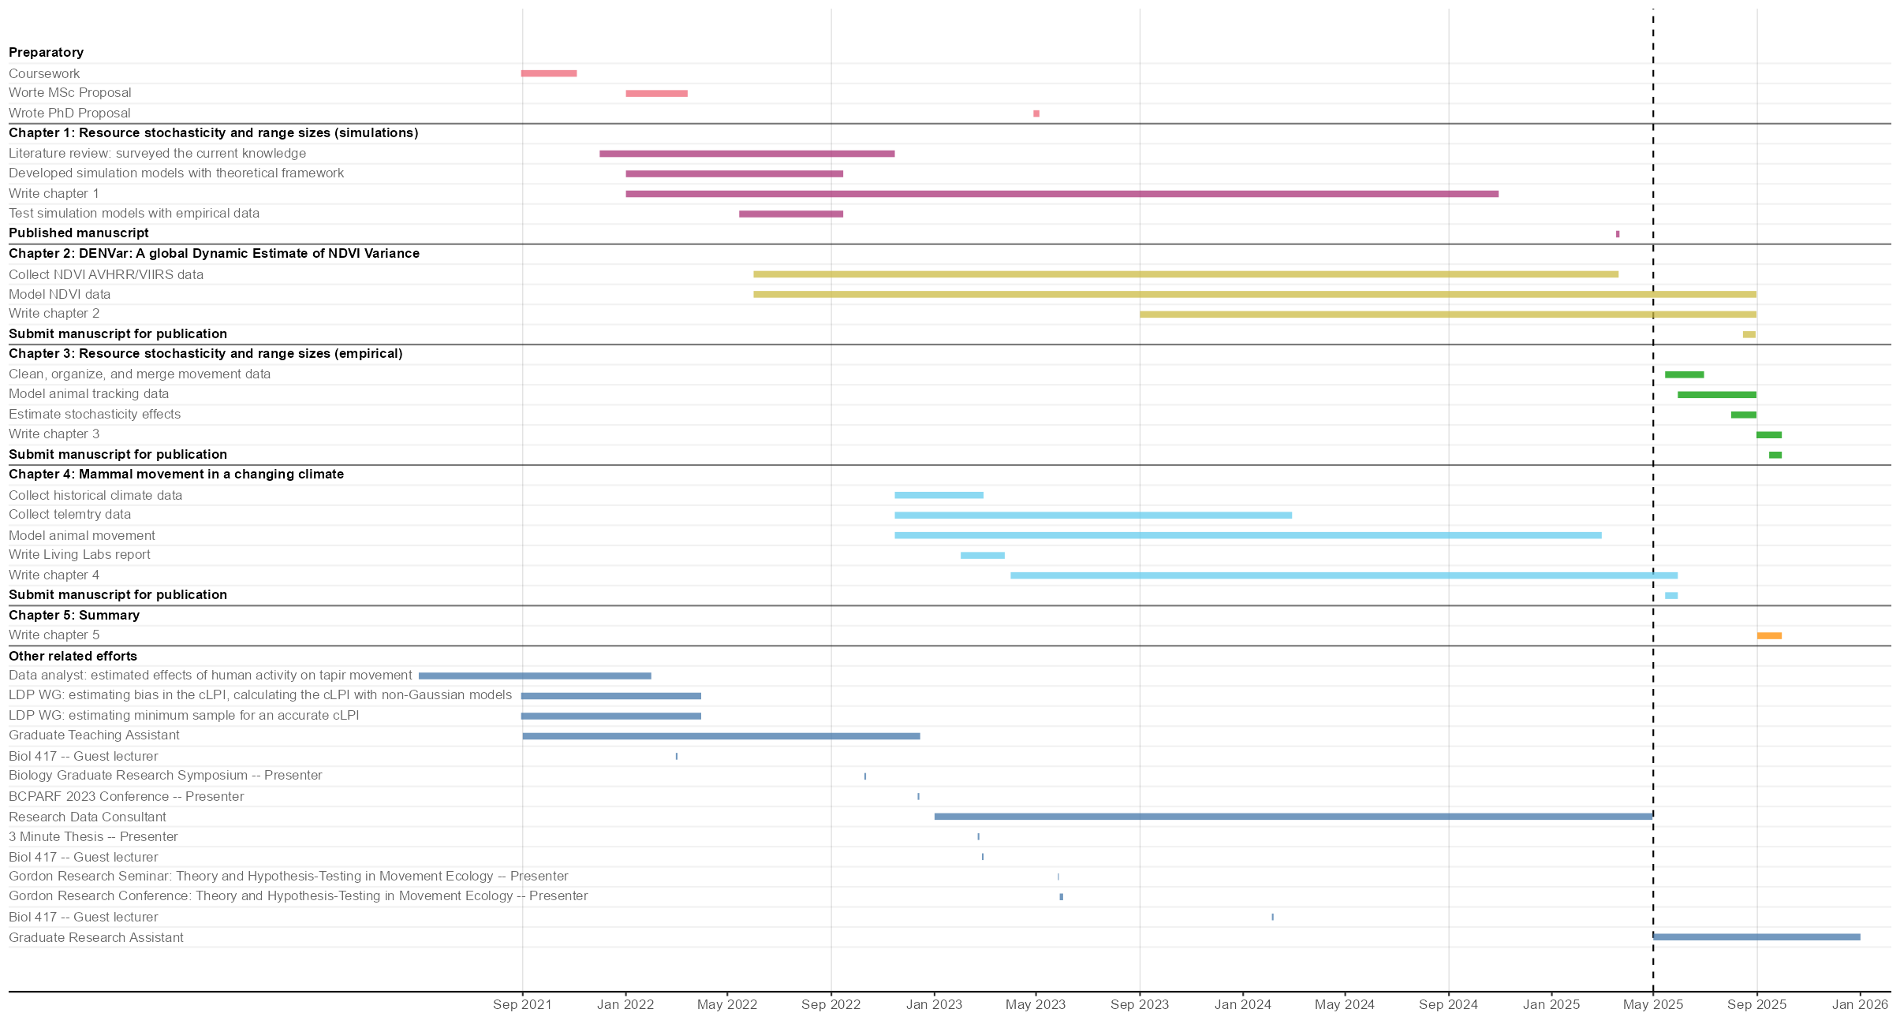

Slide 3
Manuscripts contributed to during the thesis
Mezzini S., Fleming C.H., Medici E.P. & Noonan M.J. (2025). How resource abundance and resource stochasticity affect organisms’ range sizes. Movement Ecology 13, 20. https://doi.org/10.1186/s40462-025-00546-5
DeNicola V.L., Mezzini S., Bursać P., Minasandra P. & Cagnacci F. (2025). Effects of vasectomy on breeding-related movement and activity in free-ranging white-tailed deer. Accepted for publication in Movement Ecology.
Gaynor K.M., Chhen A., Cuadros S., ..., Mezzini S., Marley J., & Noonan M.J. (2025). The human shield hypothesis: does predator avoidance of humans create refuges for prey? Accepted for publication in Ecology Letters.
Shaw A.K., Fouda L., Mezzini S., Kim D., Chatterjee N., Wolfson D., Abrahms B., et al. (2025). Perceived and observed biases within scientific communities: a case study in movement ecology. Accepted for publication in Proc. R. Soc. B.
Mezzini S., DeNicola V.L., Cagnacci F., & Fleming C.H. (2025). Are your Data too Coarse for Speed Estimation? Diffusion Rates as an Alternative Measure of Animal Movement. Submitted for publication.
DeNicola V.L., Mezzini S., & Cagnacci F. (2024). Effects of Ovariectomy on Seasonal Movement Behavior in Suburban Female White-Tailed Deer. Submitted for publication.
Purcell S.A., Shillito J., Mezzini S., Shirin S., Prior J.C. (2025). Appetite, menstrual cycles, and ovulation: experiences recorded in consecutive cycles in healthy premenopausal women. Submitted for publication.
Loverock L.B., Mezzini S., Berch S., Hannam K., Jones M.D., & Durall D.M. (2023). The effect of irrigation on T. melanosporum extramatrical mycelium and on the soil and root ectomycorrhizal community in a Canadian truffle orchard during an unprecedented heat and moderate drought. Submitted for publication.
Gushulak C.A.C., Chegoonian A.M., Wolfe J., Gray K., Mezzini S., Wissel B., et al. (2024). Impacts of hydrologic management on the eutrophication of shallow lakes in an intensive agricultural landscape(Saskatchewan, Canada). Freshwater Biology 69, 984–1000. https://doi.org/10.1111/fwb.14260
Weststrate D.K., Chhen A., Mezzini S., Safford K. & Noonan M.J. (2024). How climate change and population growth will shape attendance and human-wildlife interactions at British Columbia parks. Journal of Sustainable Tourism, 1–15. https://doi.org/10.1080/09669582.2024.2331228
Gushulak C.A.C., Mezzini S., Moir K.E., Simpson G.L., Bunting L., Wissel B., et al. (2024). Impacts of a century of land-use change on the eutrophication of large, shallow, prairie Lake Manitoba in relation to adjacent Lake Winnipeg (Manitoba, Canada). Freshwater Biology 69, 47–63. https://doi.org/10.1111/fwb.14192
Currie J., Burant J.B., Marconi V., …, Mezzini S., Pata P., & Freeman R. (2022). Assessing the representation of species included within the Canadian Living Planet Index. FACETS 7, 1121–1141.https://doi.org/10.1139/facets-2022-0063
Bjorndahl J.A., Gushulak C.A.C., Mezzini S., Simpson G.L., Haig H.A., Leavitt P.R., et al.(2022). Abrupt changes in the physical and biological structure of endorheic upland lakes due to 8-m lake-level variation during the 20th century. Limnology and Oceanography 67, 1022–1039.https://doi.org/10.1002/lno.12054
Medici E.P., Mezzini S., Fleming C.H., Calabrese J.M. & Noonan M.J. (2022). Movement ecology of vulnerable lowland tapirs between areas of varying human disturbance. Movement Ecology 10, 14.https://doi.org/10.1186/s40462-022-00313-w37

Slide 4
Chapter 1: Resource stochasticity and range sizes

Slide 5
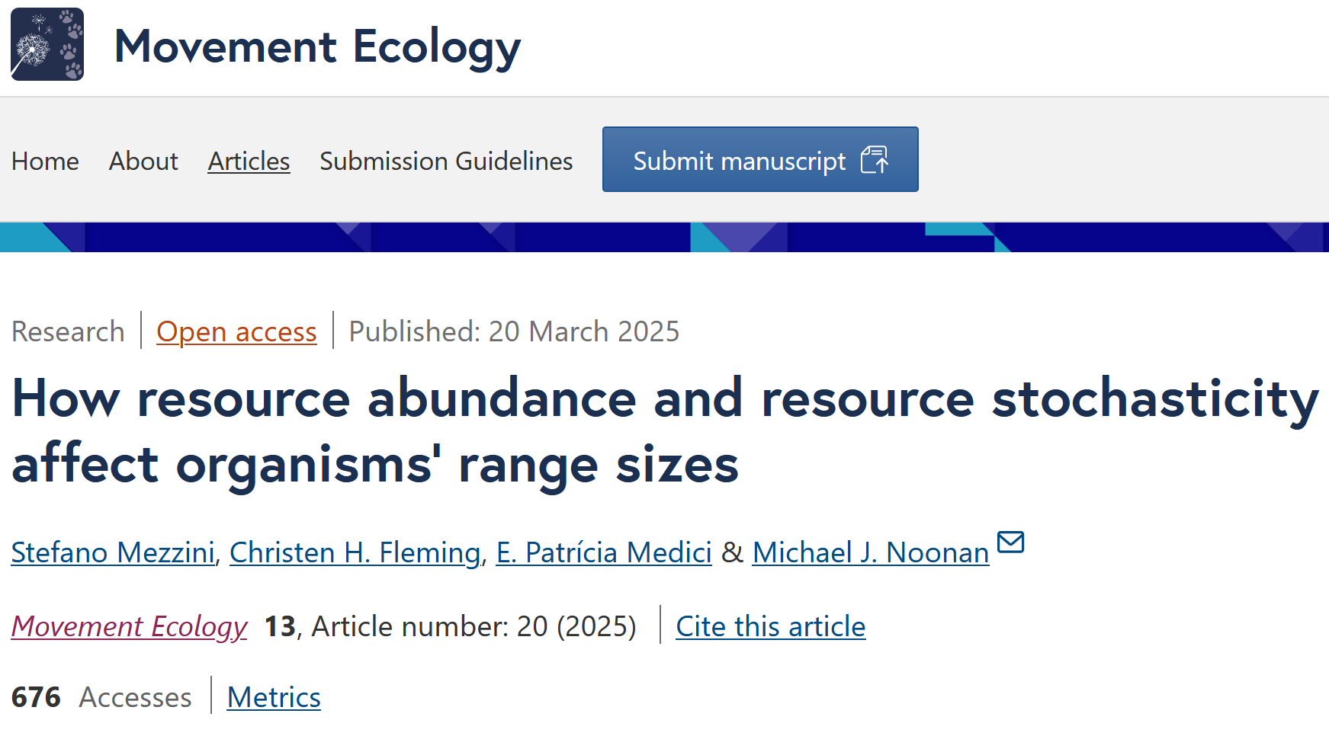
Mezzini et al. (2025) https://doi.org/10.1186/s40462-025-00546-5

Slide 6
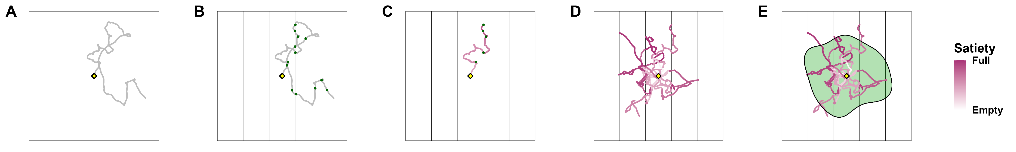
Simulating searches for resources
Fig. from Mezzini et al. (2025) https://doi.org/10.1186/s40462-025-00546-5

Slide 7
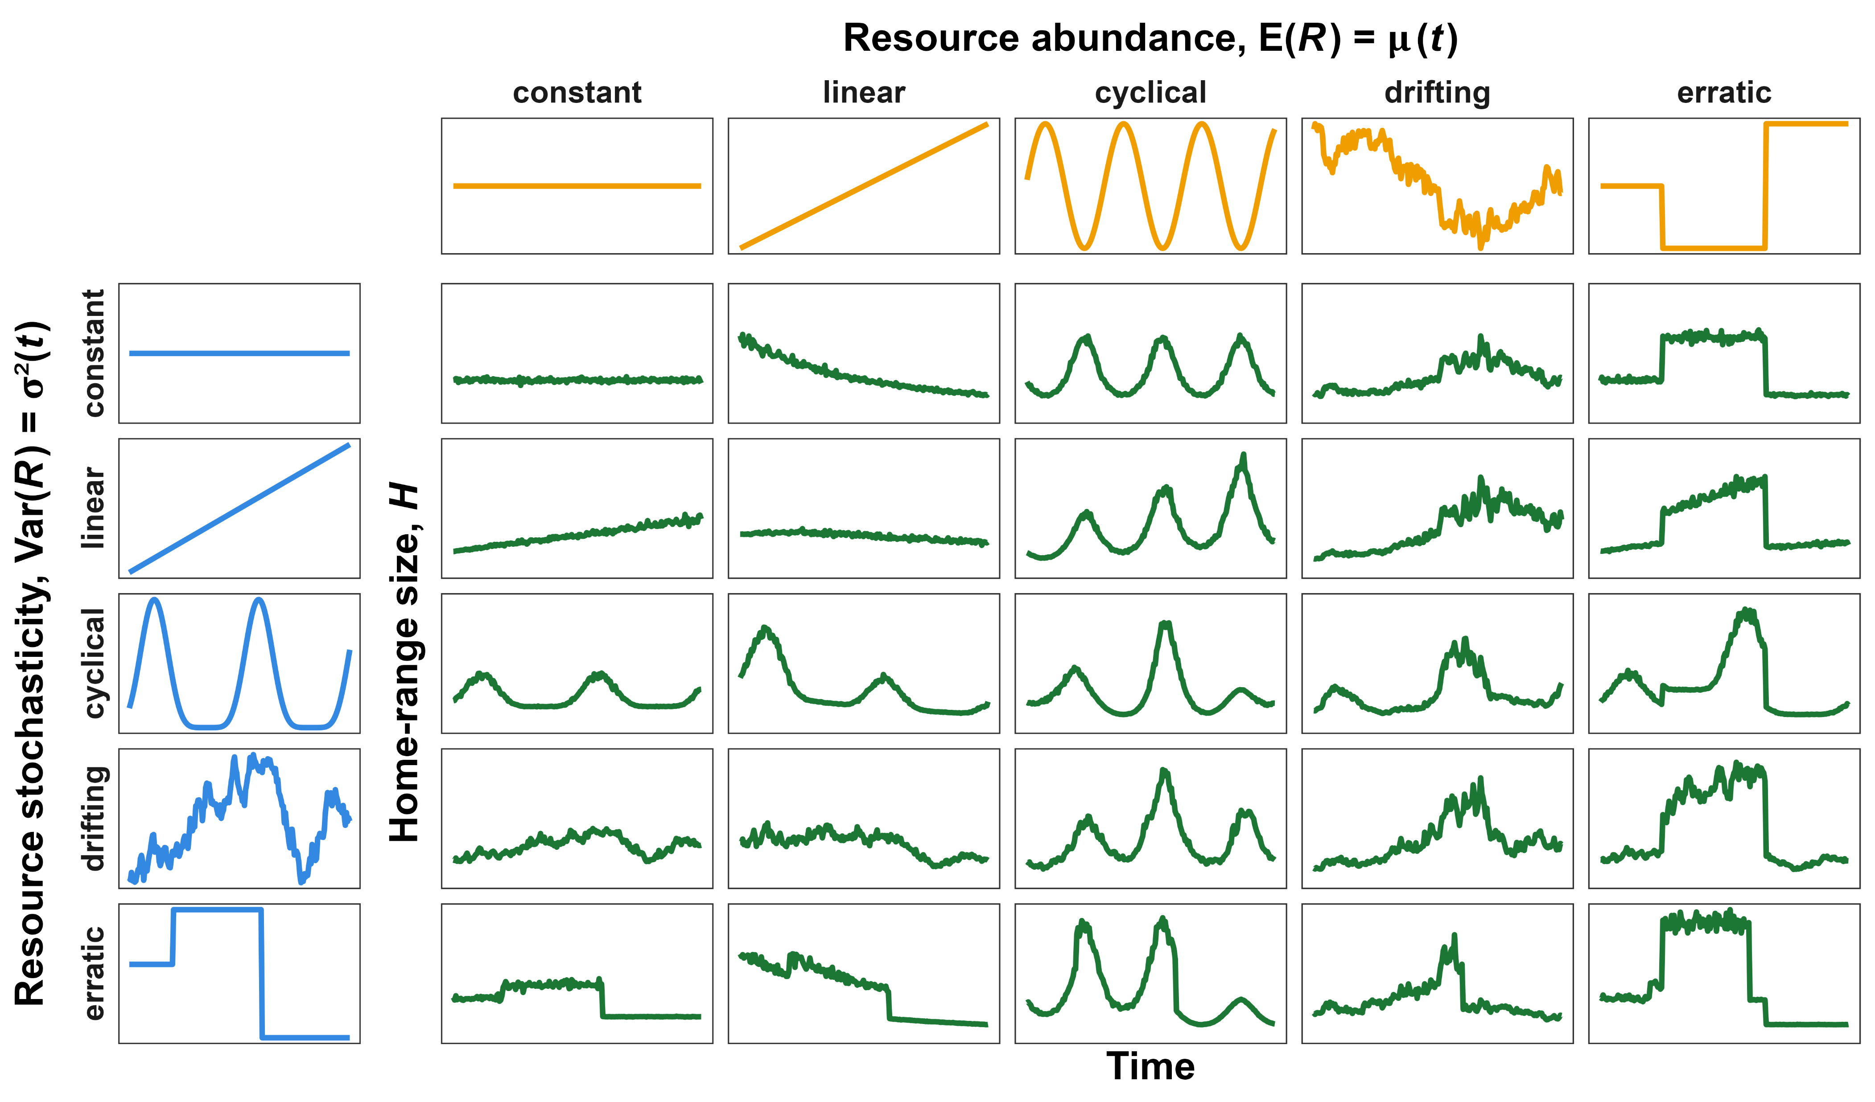
Simulating responses to resources
Fig. from Mezzini et al. (2025) https://doi.org/10.1186/s40462-025-00546-5

Slide 8
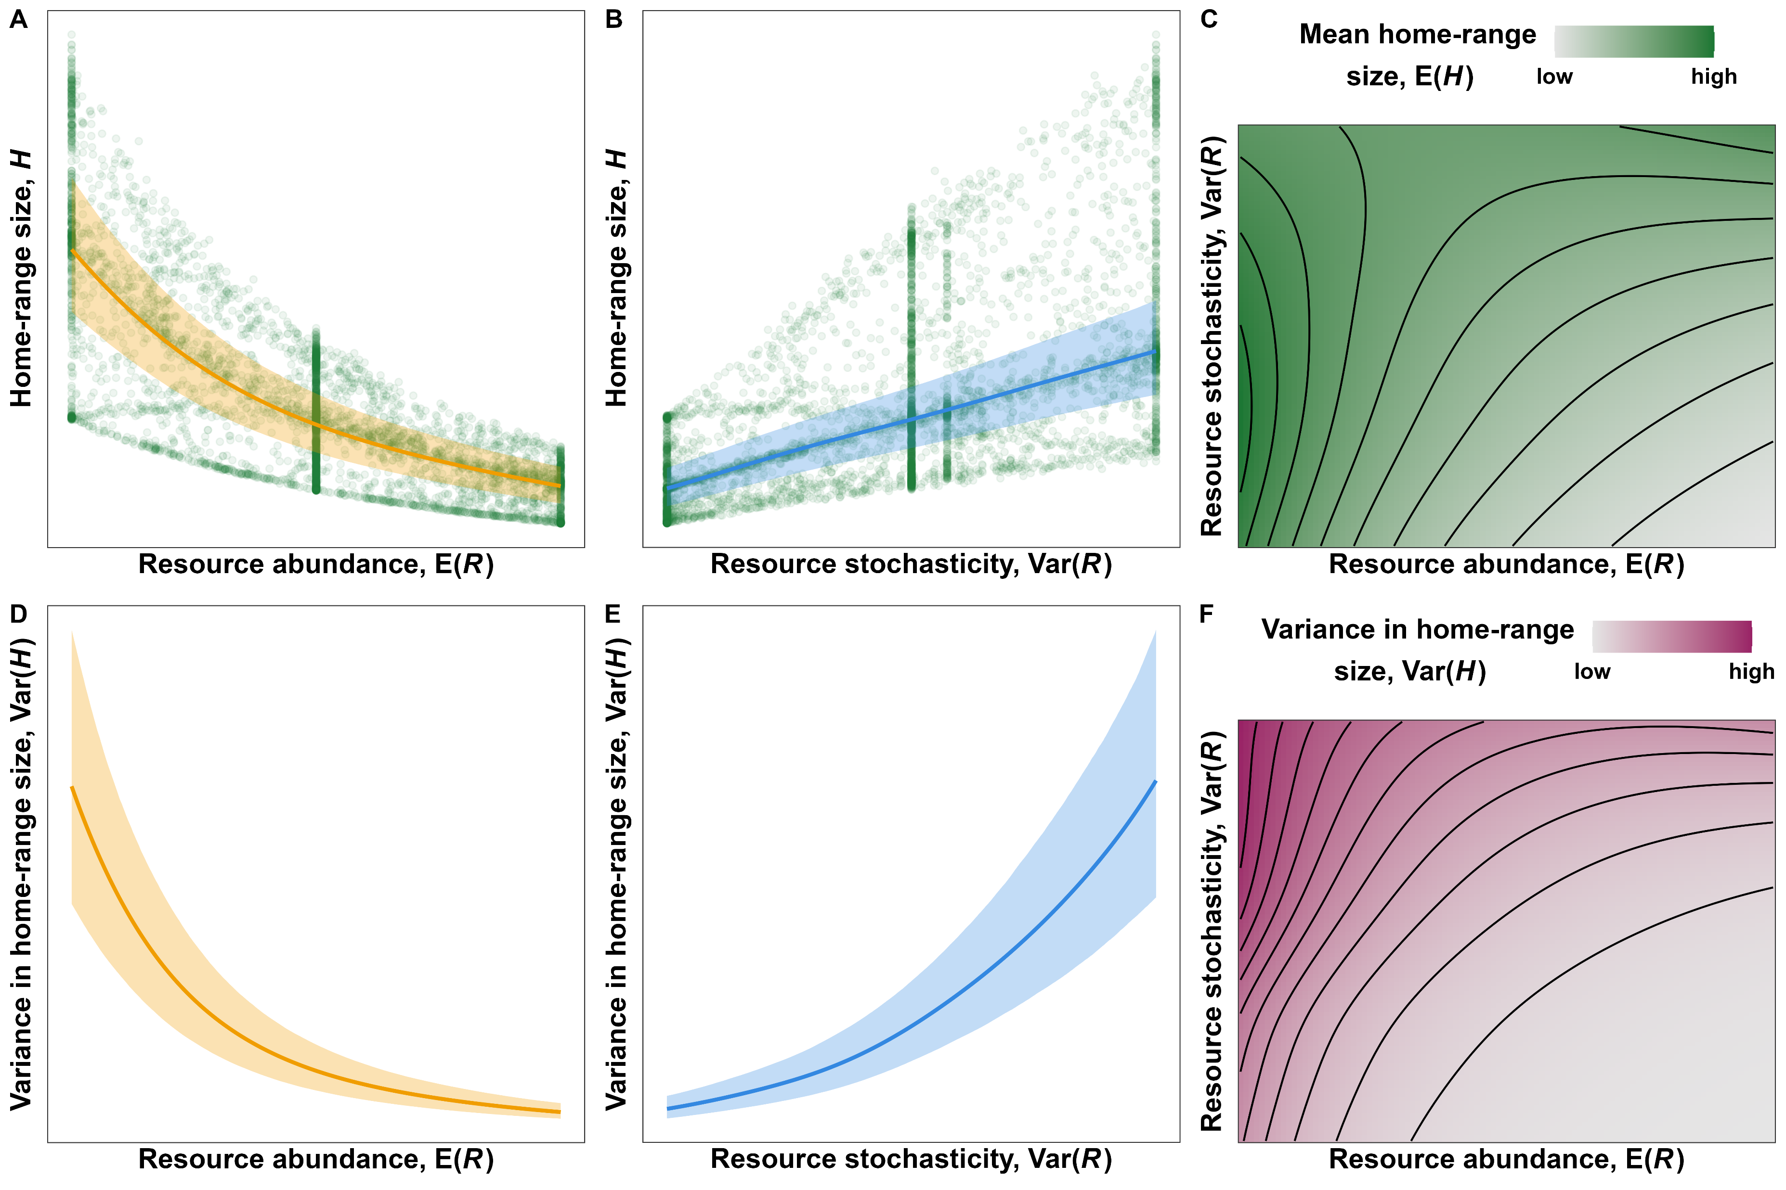
Estimating responses to resources
Fig. from Mezzini et al. (2025) https://doi.org/10.1186/s40462-025-00546-5

Slide 9

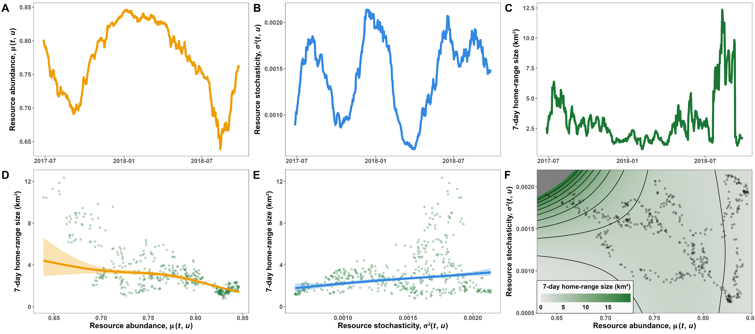
An example case study
Fig. from repo of Mezzini et al. (2025) https://doi.org/10.1186/s40462-025-00546-5

Slide 10
Chapter 2: A new global estimate of environmental stochasticity

Slide 11
Why is environmental stochasticity important?
Environmental stochasticity affects:
Plant and animal phenology (e.g., timing of flowering or migration)
Animal movement behavior (Mezzini et al. 2025)
Species’ ability to respond to change (Botero et al. 2015)
Extreme events, which play crucial roles in ecology and evolution (Anderson et al. 2017, Logares at al. 2012)
Landscapes’ energetic balances and species’ ability to adapt (Lande 1993; Chevin et al. 2010; Rekha Marcus’s work*)
Forest regeneration after fires or cutting (Daniella DeVries’s work*)
Forest fire occurrence (Avery Collinson’s work*)
*other members of the Quantitative Ecology Lab

Slide 12
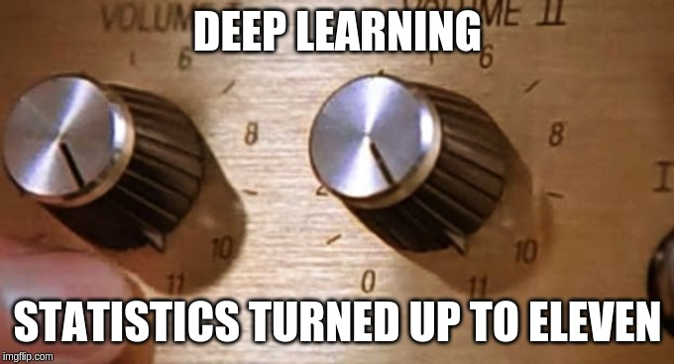
Why not just use deep learning?
Results can be highly accurate but are rarely interpretable
We need communicable models and predictions
We need sensible stats models
From Simpson, Hinz, and Mezzini (2019)

Slide 13
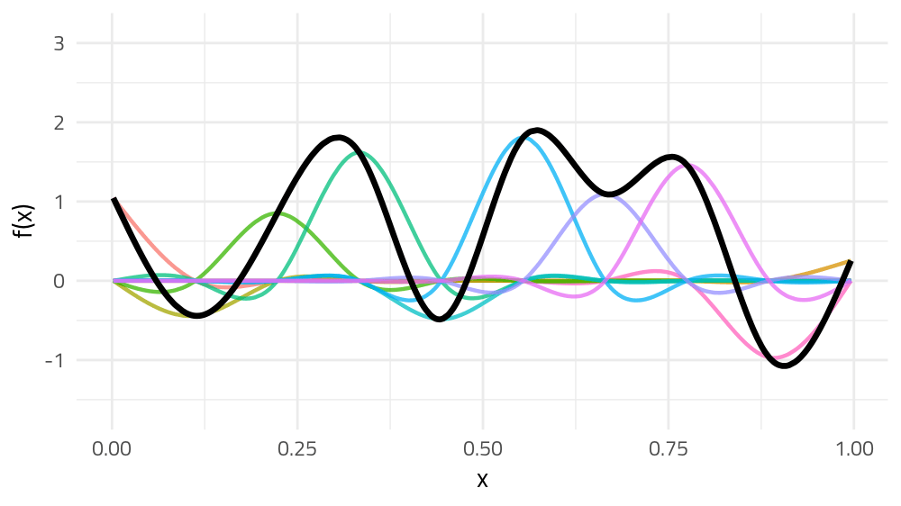
GAMs: flexible yet interpretable models
From Simpson, Hinz, and Mezzini (2019)

Slide 14
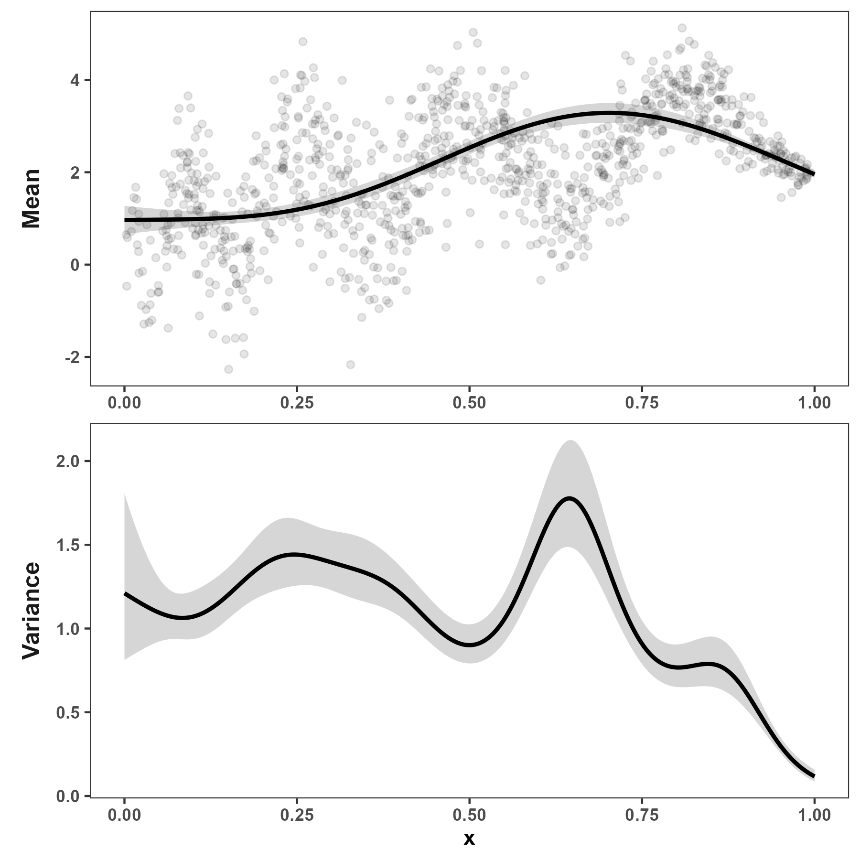
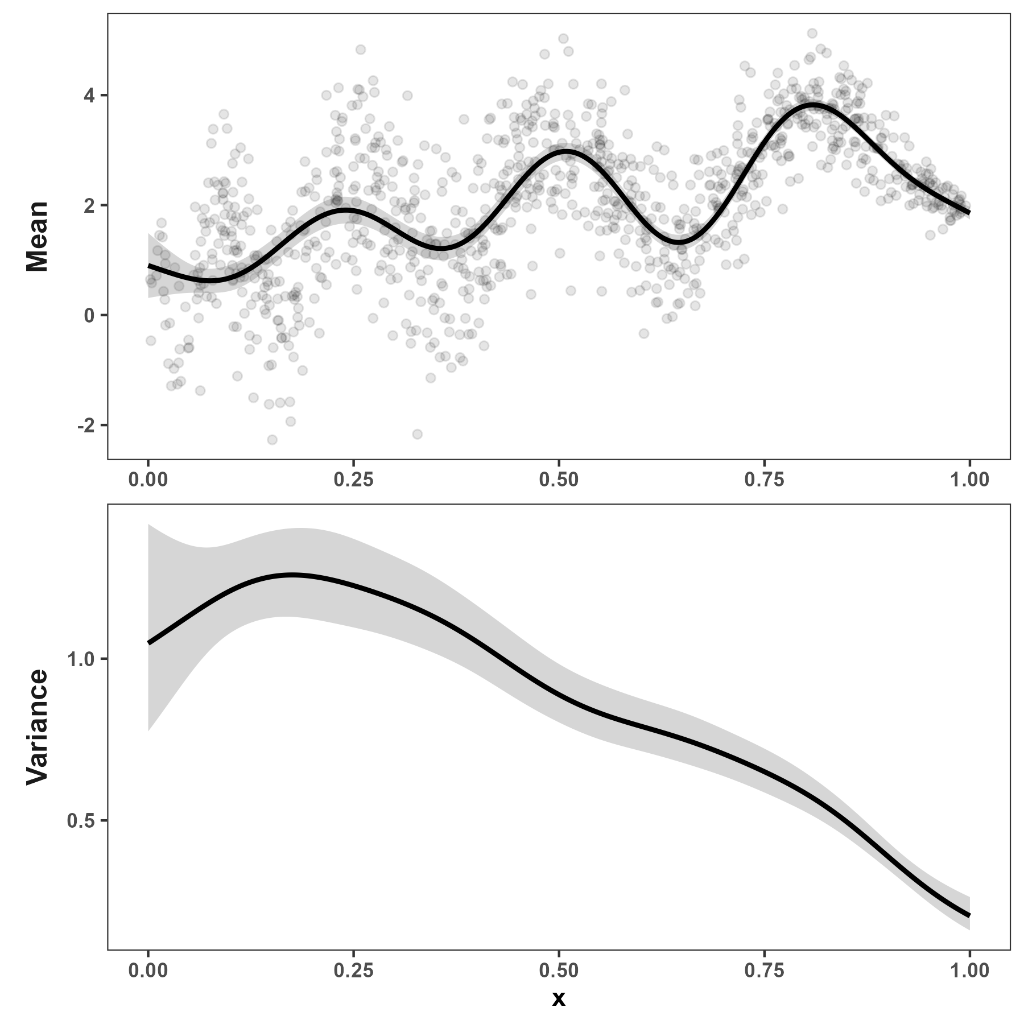
Variance estimate depends on mean estimate
Smooth mean gives large, wiggly variance
Wiggly mean gives small, smooth variance

Slide 15
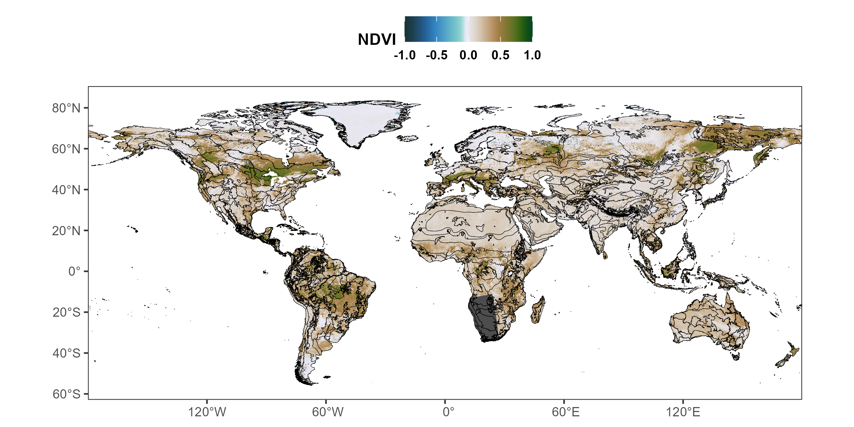
AVHRR/VIIRS: daily NDVI data at a 0.05° resolution

Slide 16
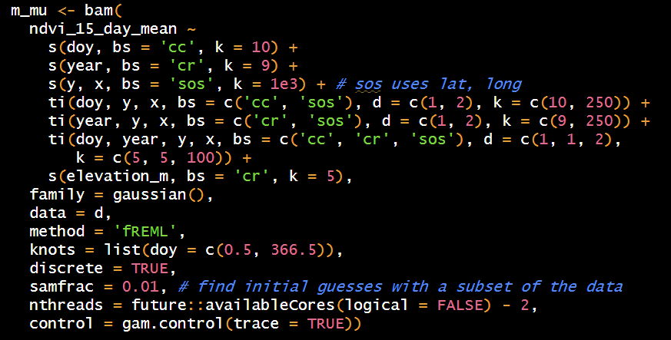
Estimating mean NDVI

Slide 17
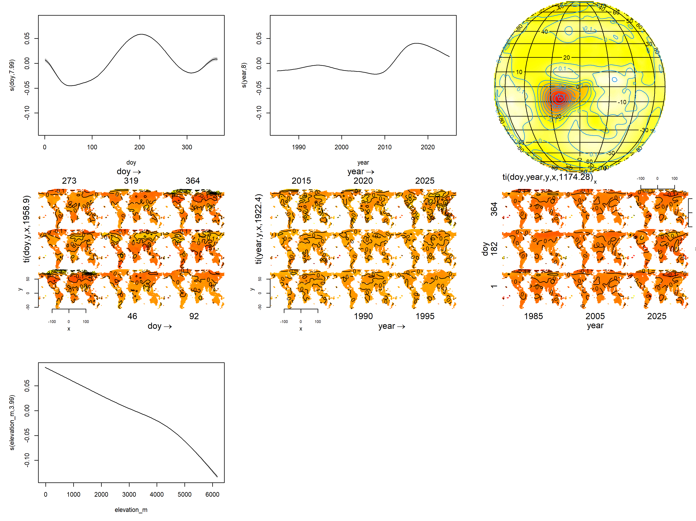
Estimating mean NDVI

Slide 18
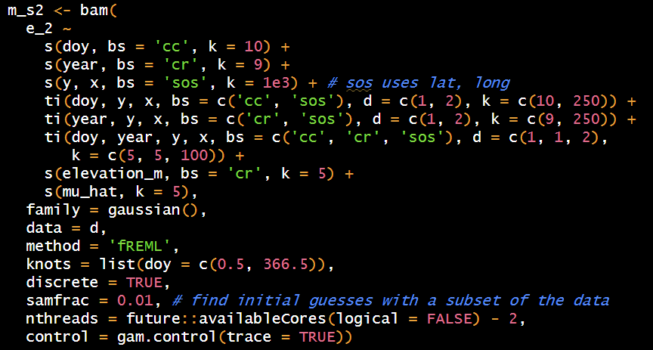
Estimating variance in NDVI

Slide 19
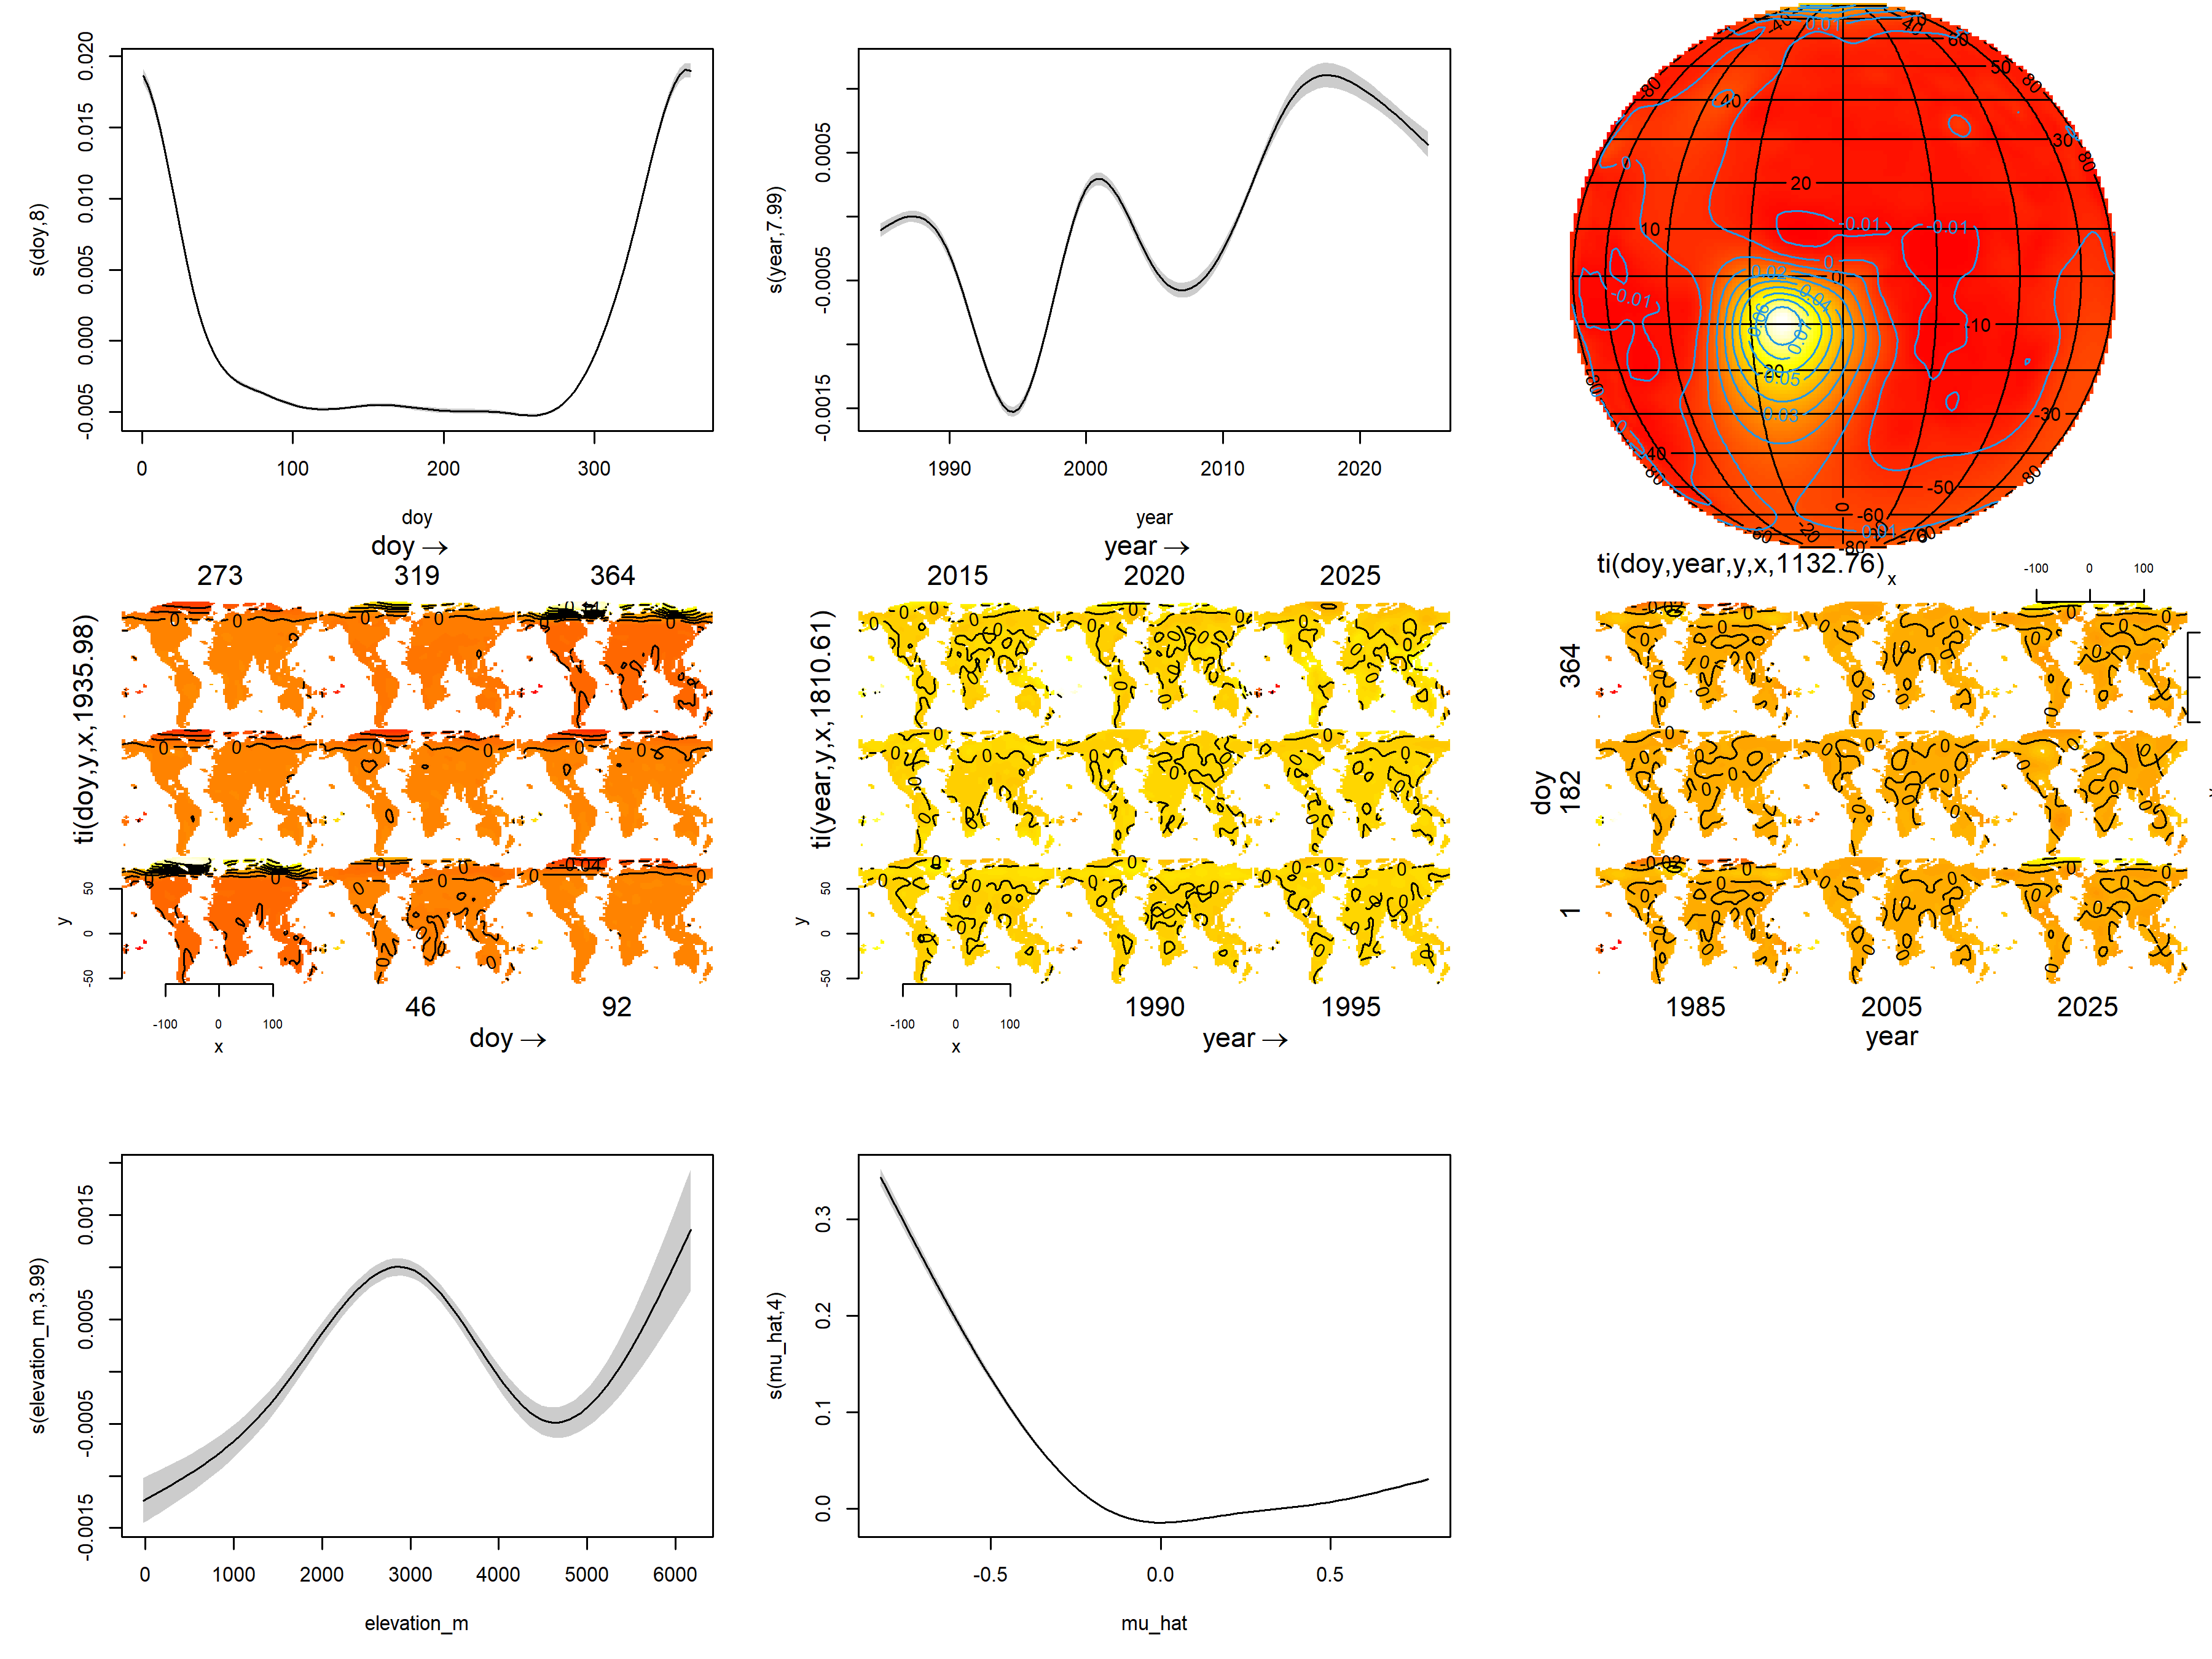
Estimating variance in NDVI

Slide 20
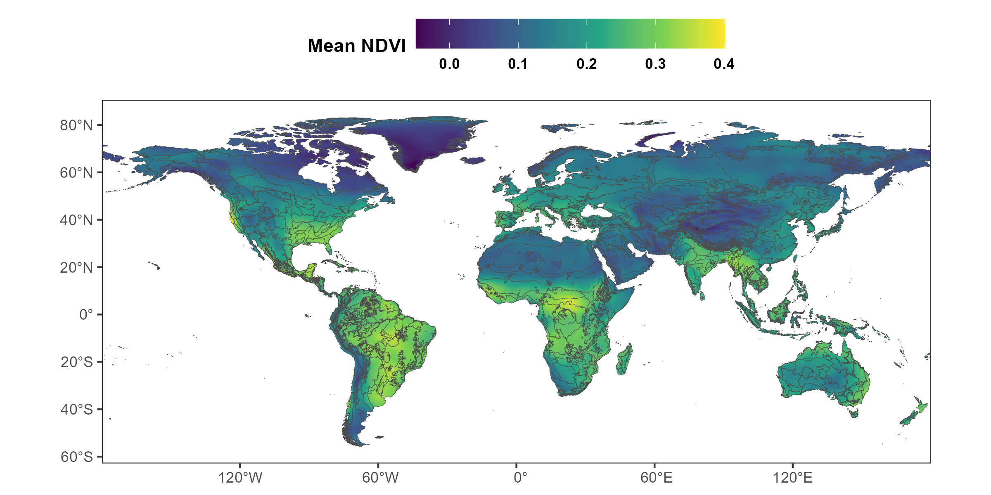
Model predictions: Mean NDVI

Slide 21
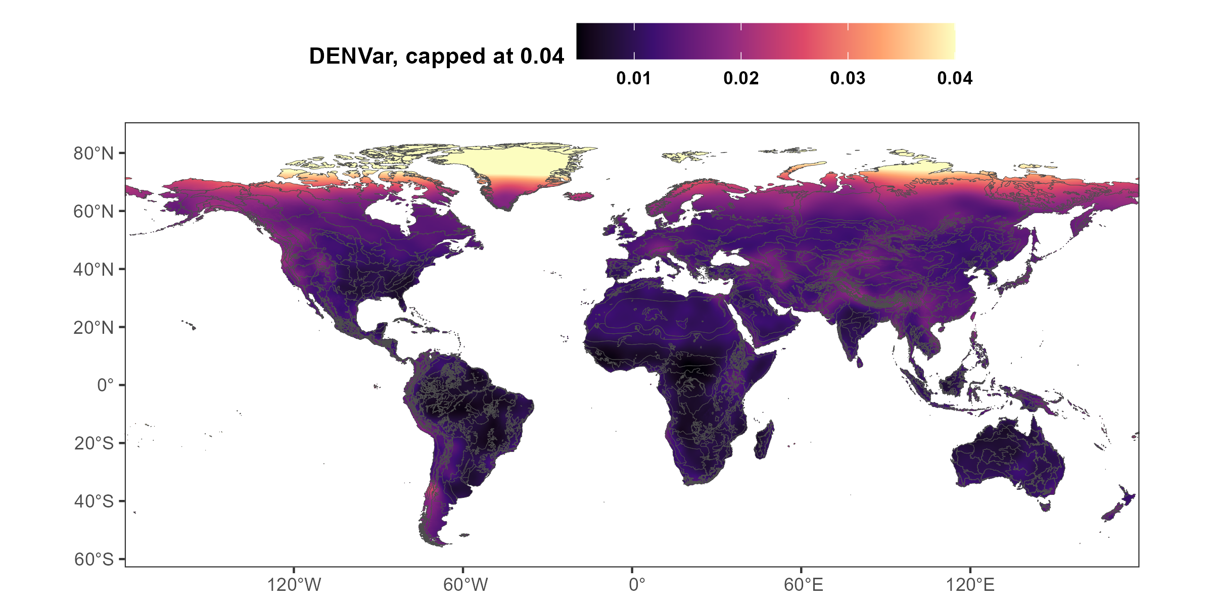
Model predictions: DENVar

Slide 22
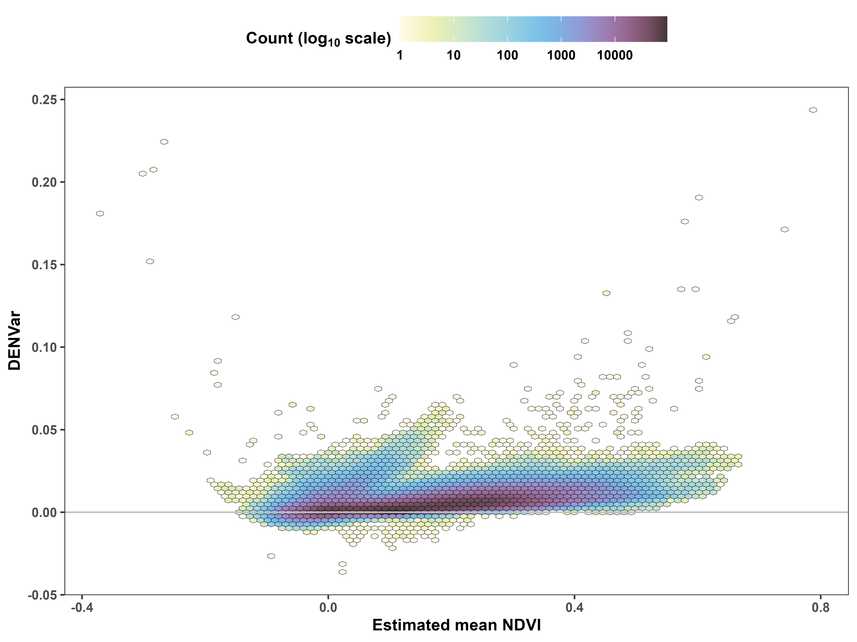
Mean and variance estimates are correlated

Slide 23
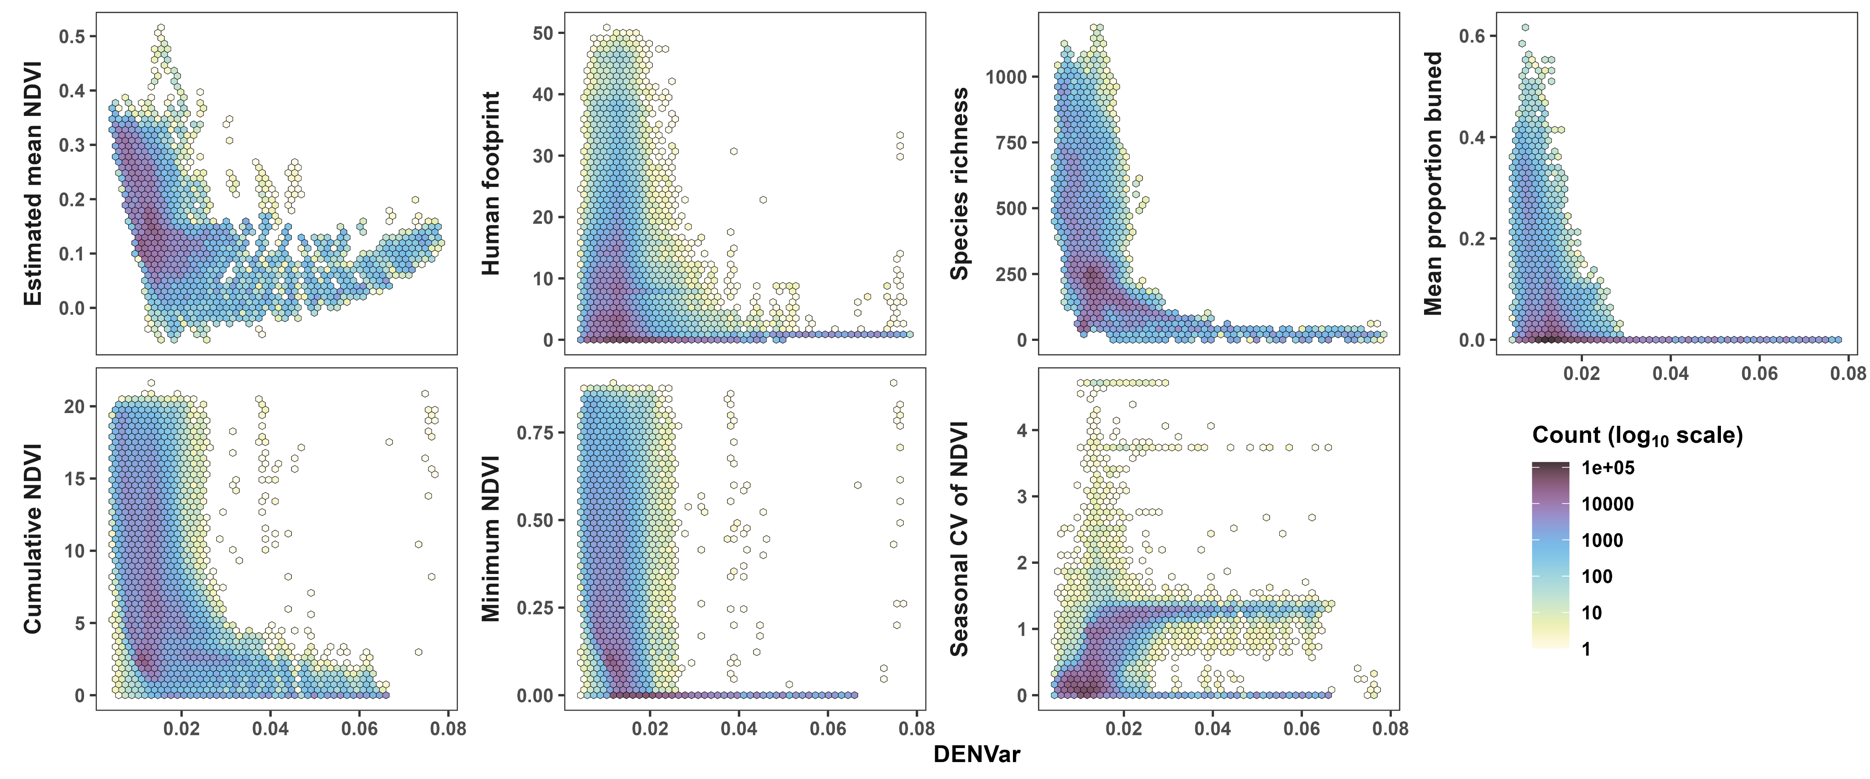
DENVar is correlated with other metrics, too

Slide 24
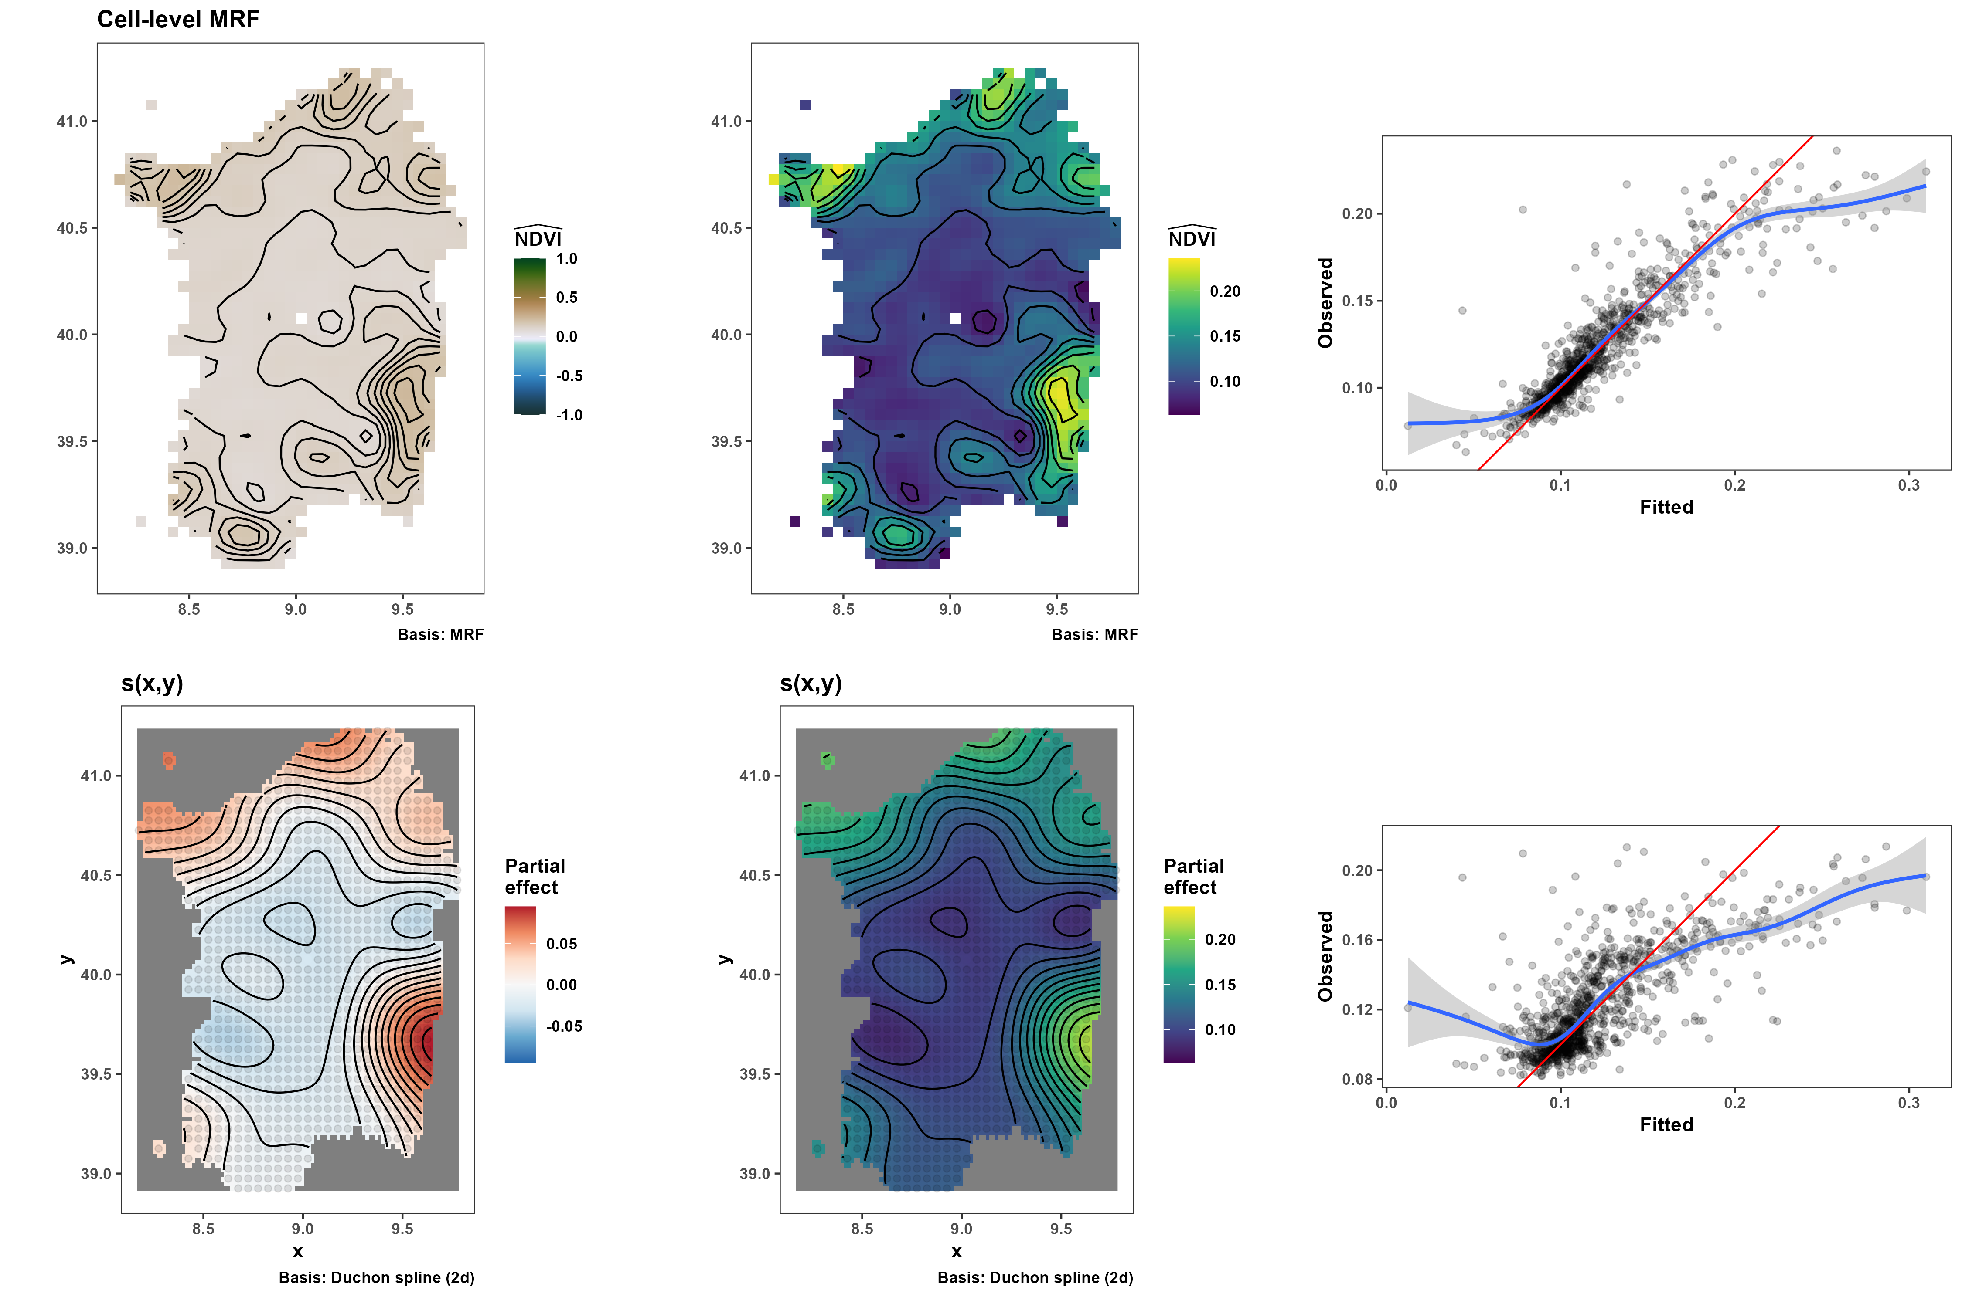
A test using a cell-level MRF

Slide 25
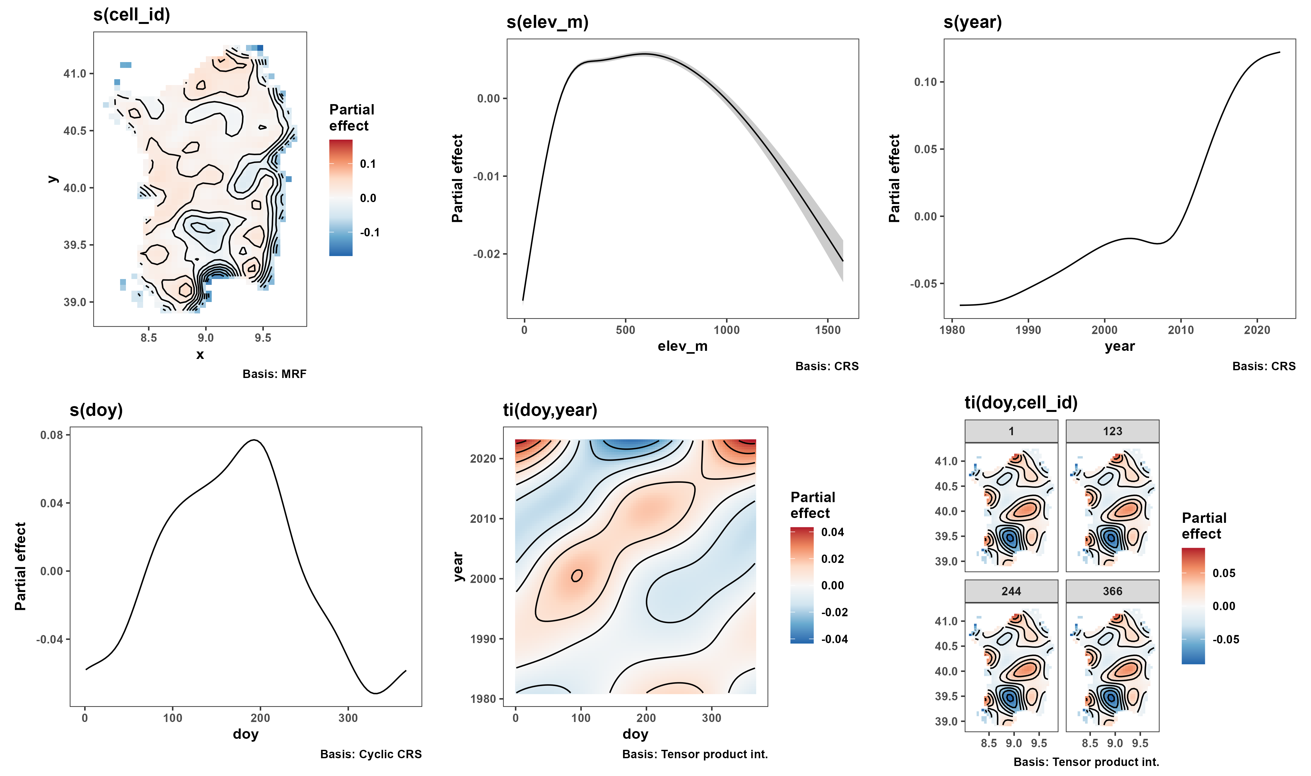
A test using a cell-level MRF (2)

Slide 26
Chapter 3: An empirical test of resource stochasticity and range size

Slide 27
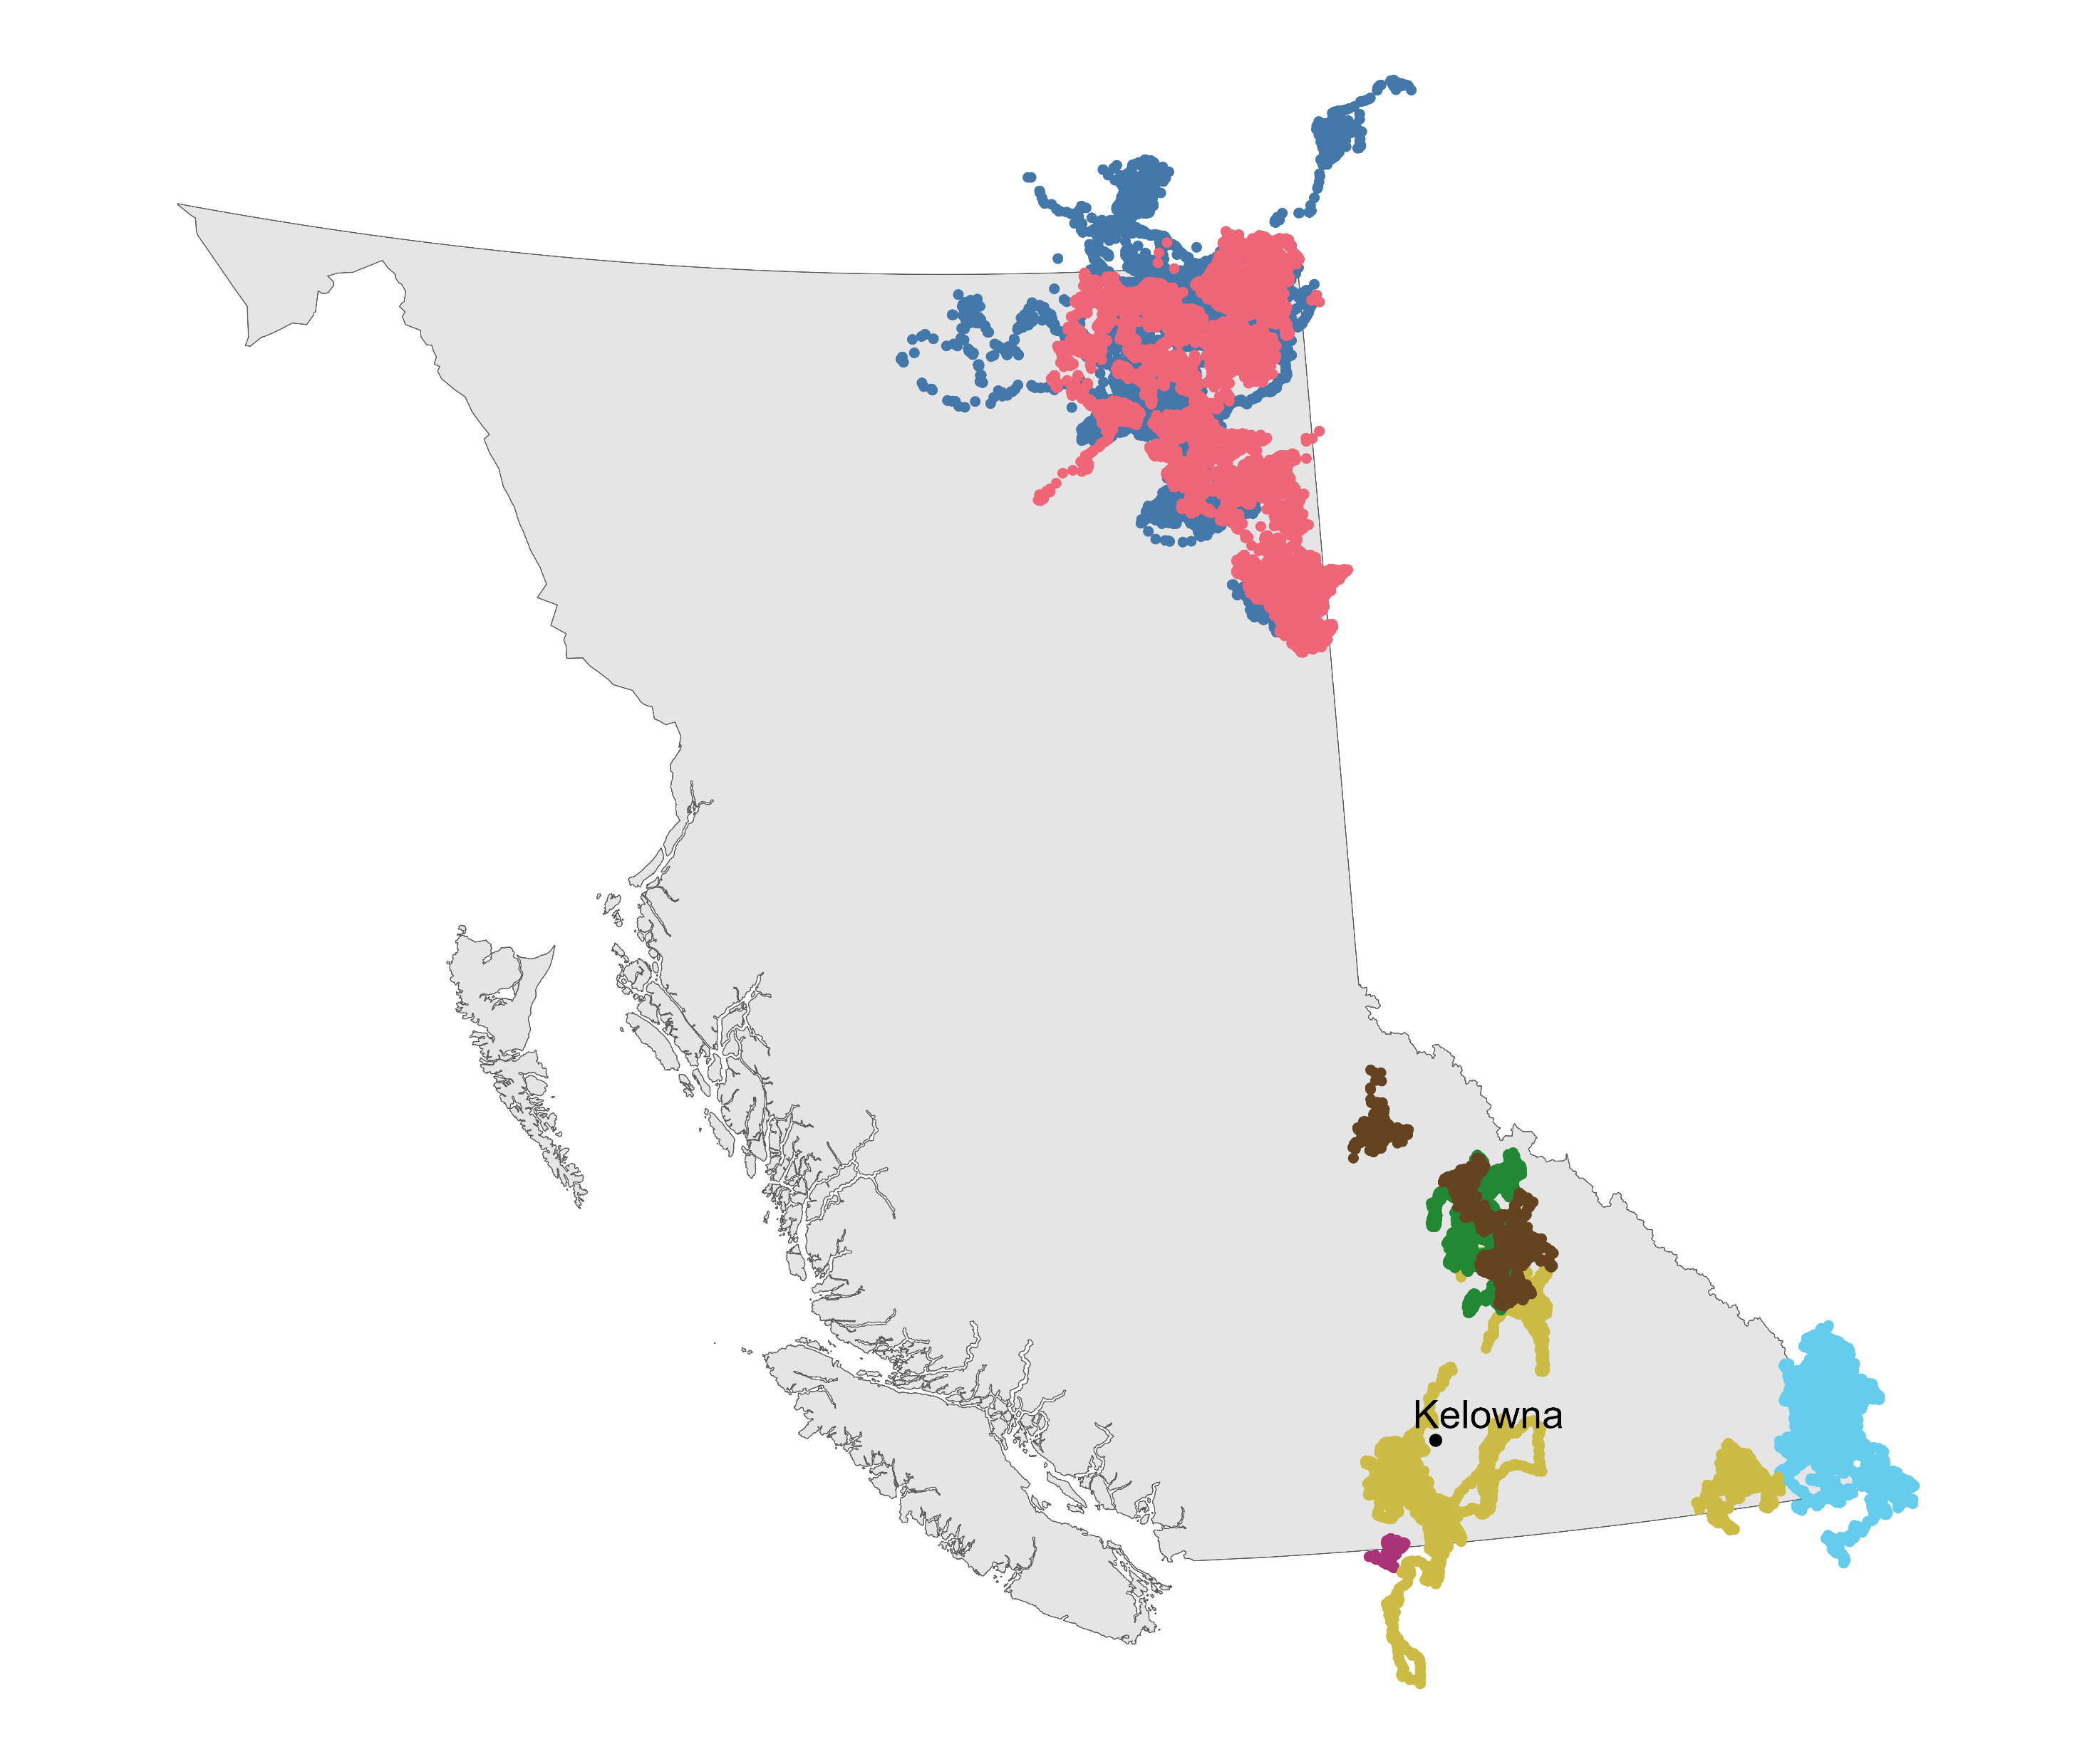



Slide 28
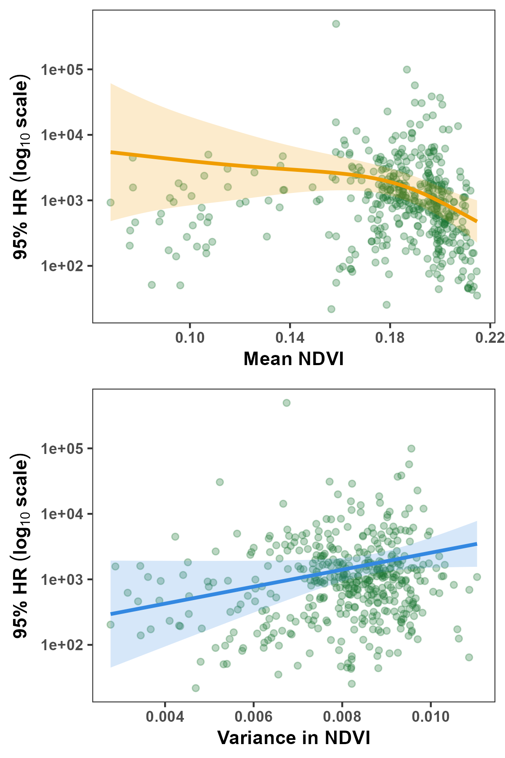
A quick test with some BC mammals

Slide 29
Chapter 4: Temperature and mammal movement behavior

Slide 31
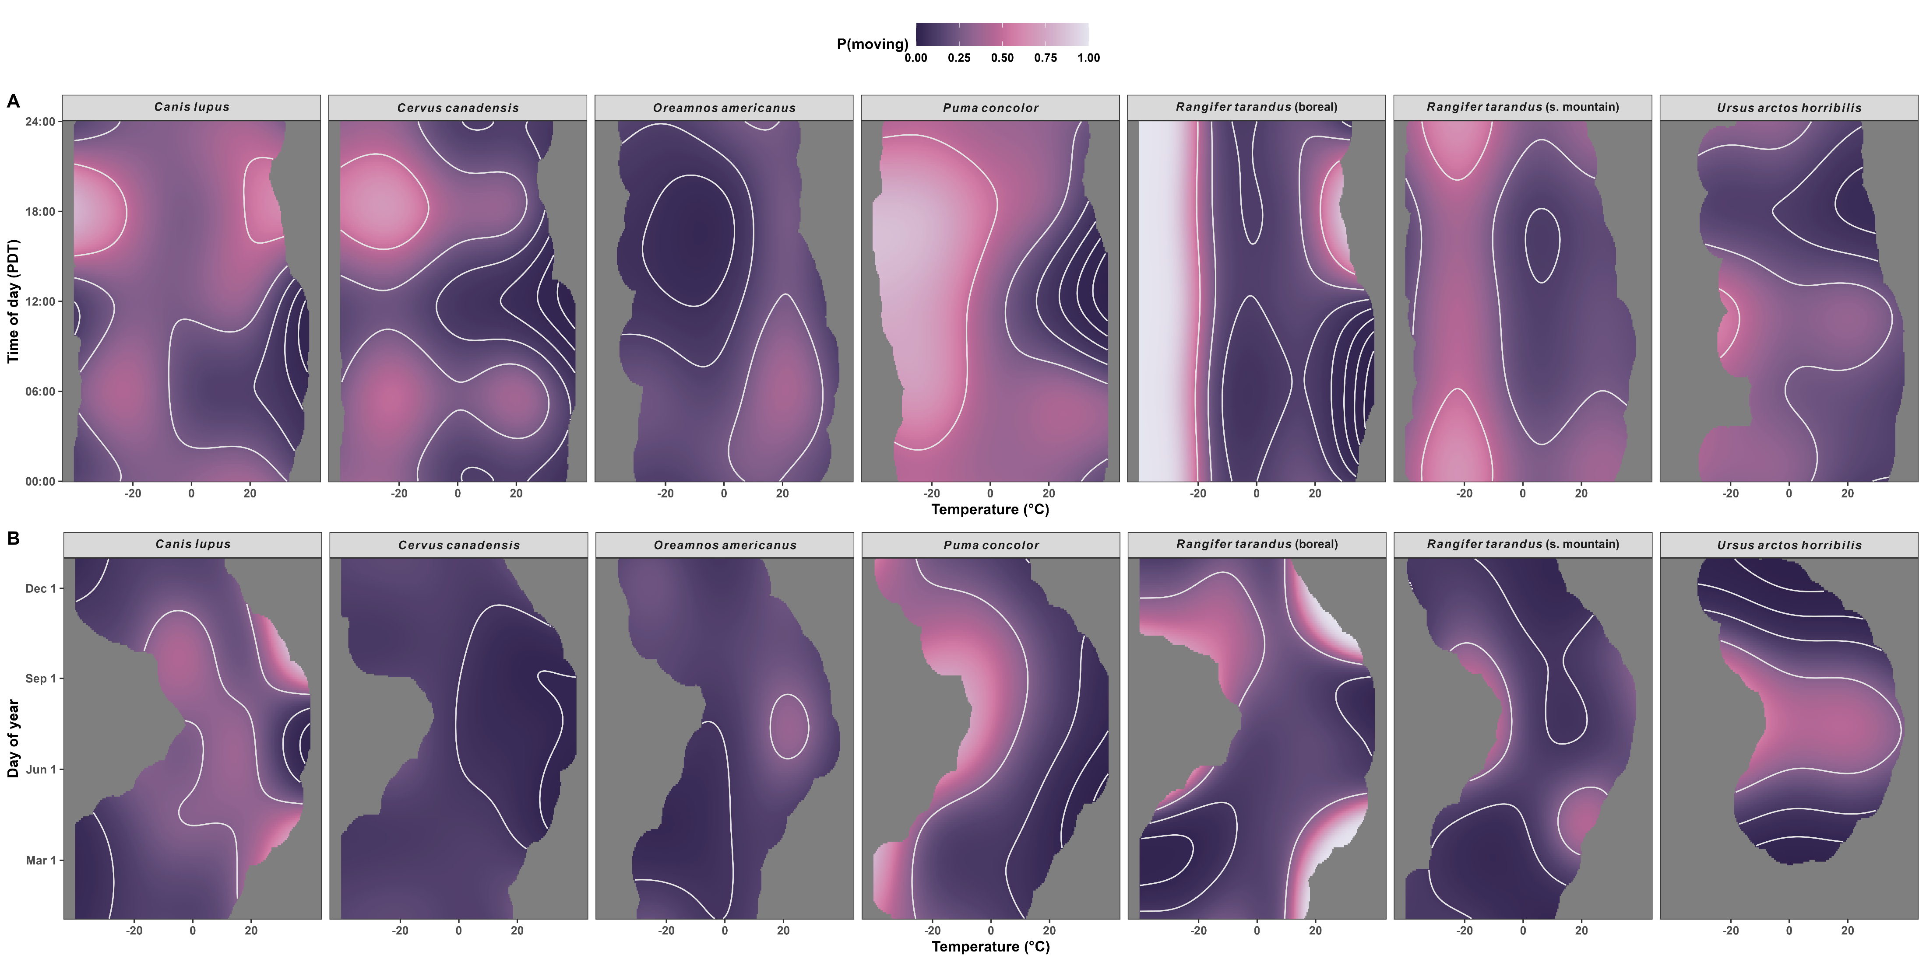
Movement frequency depends on temperature

Slide 32
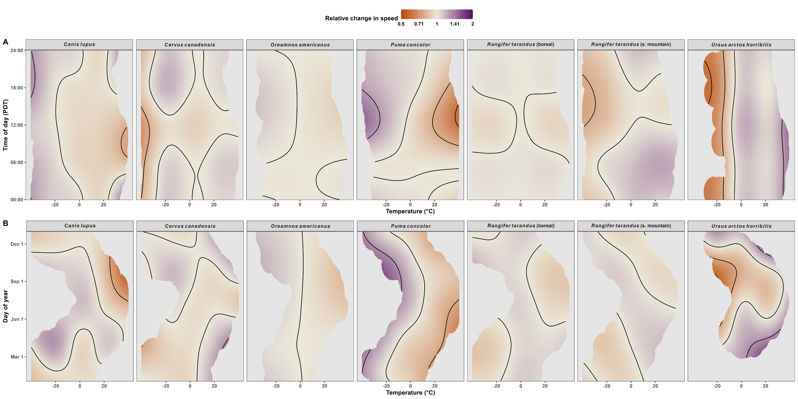
Movement speed depends on temperature

Slide 33
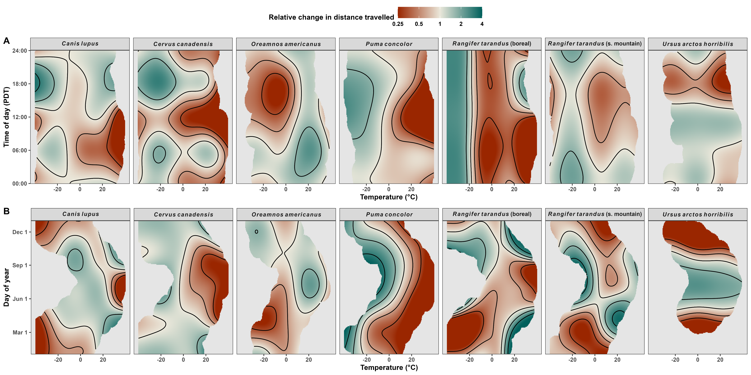
Distance traveled depends on temperature

Slide 34
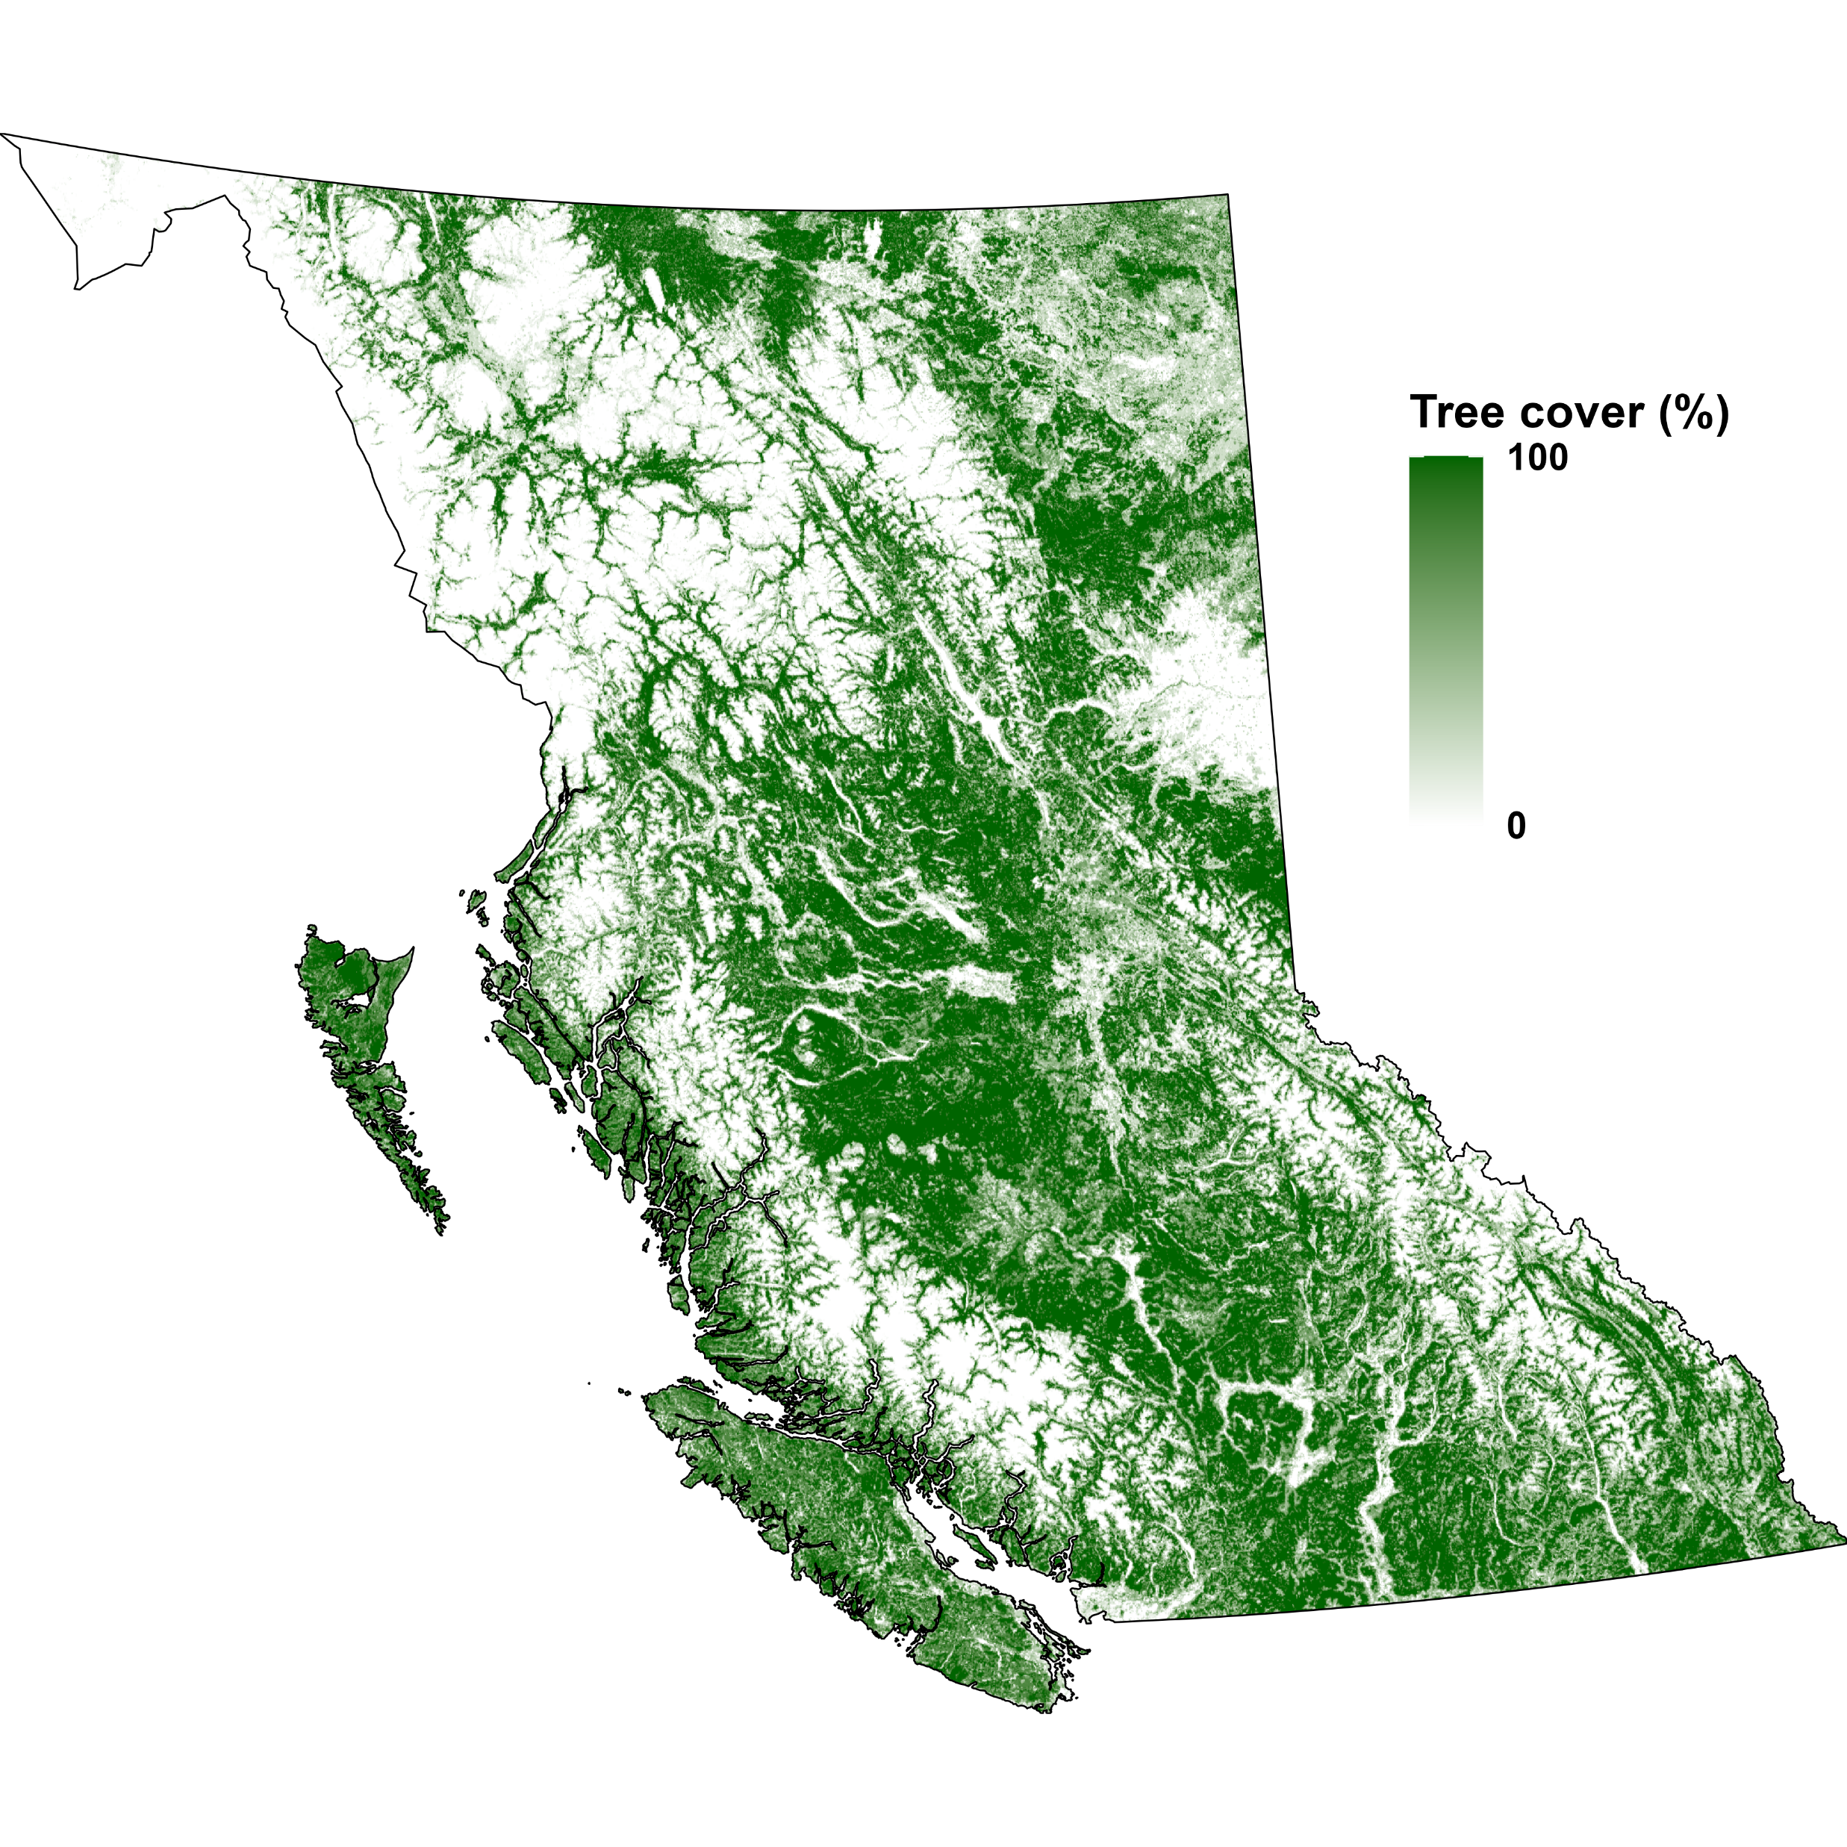
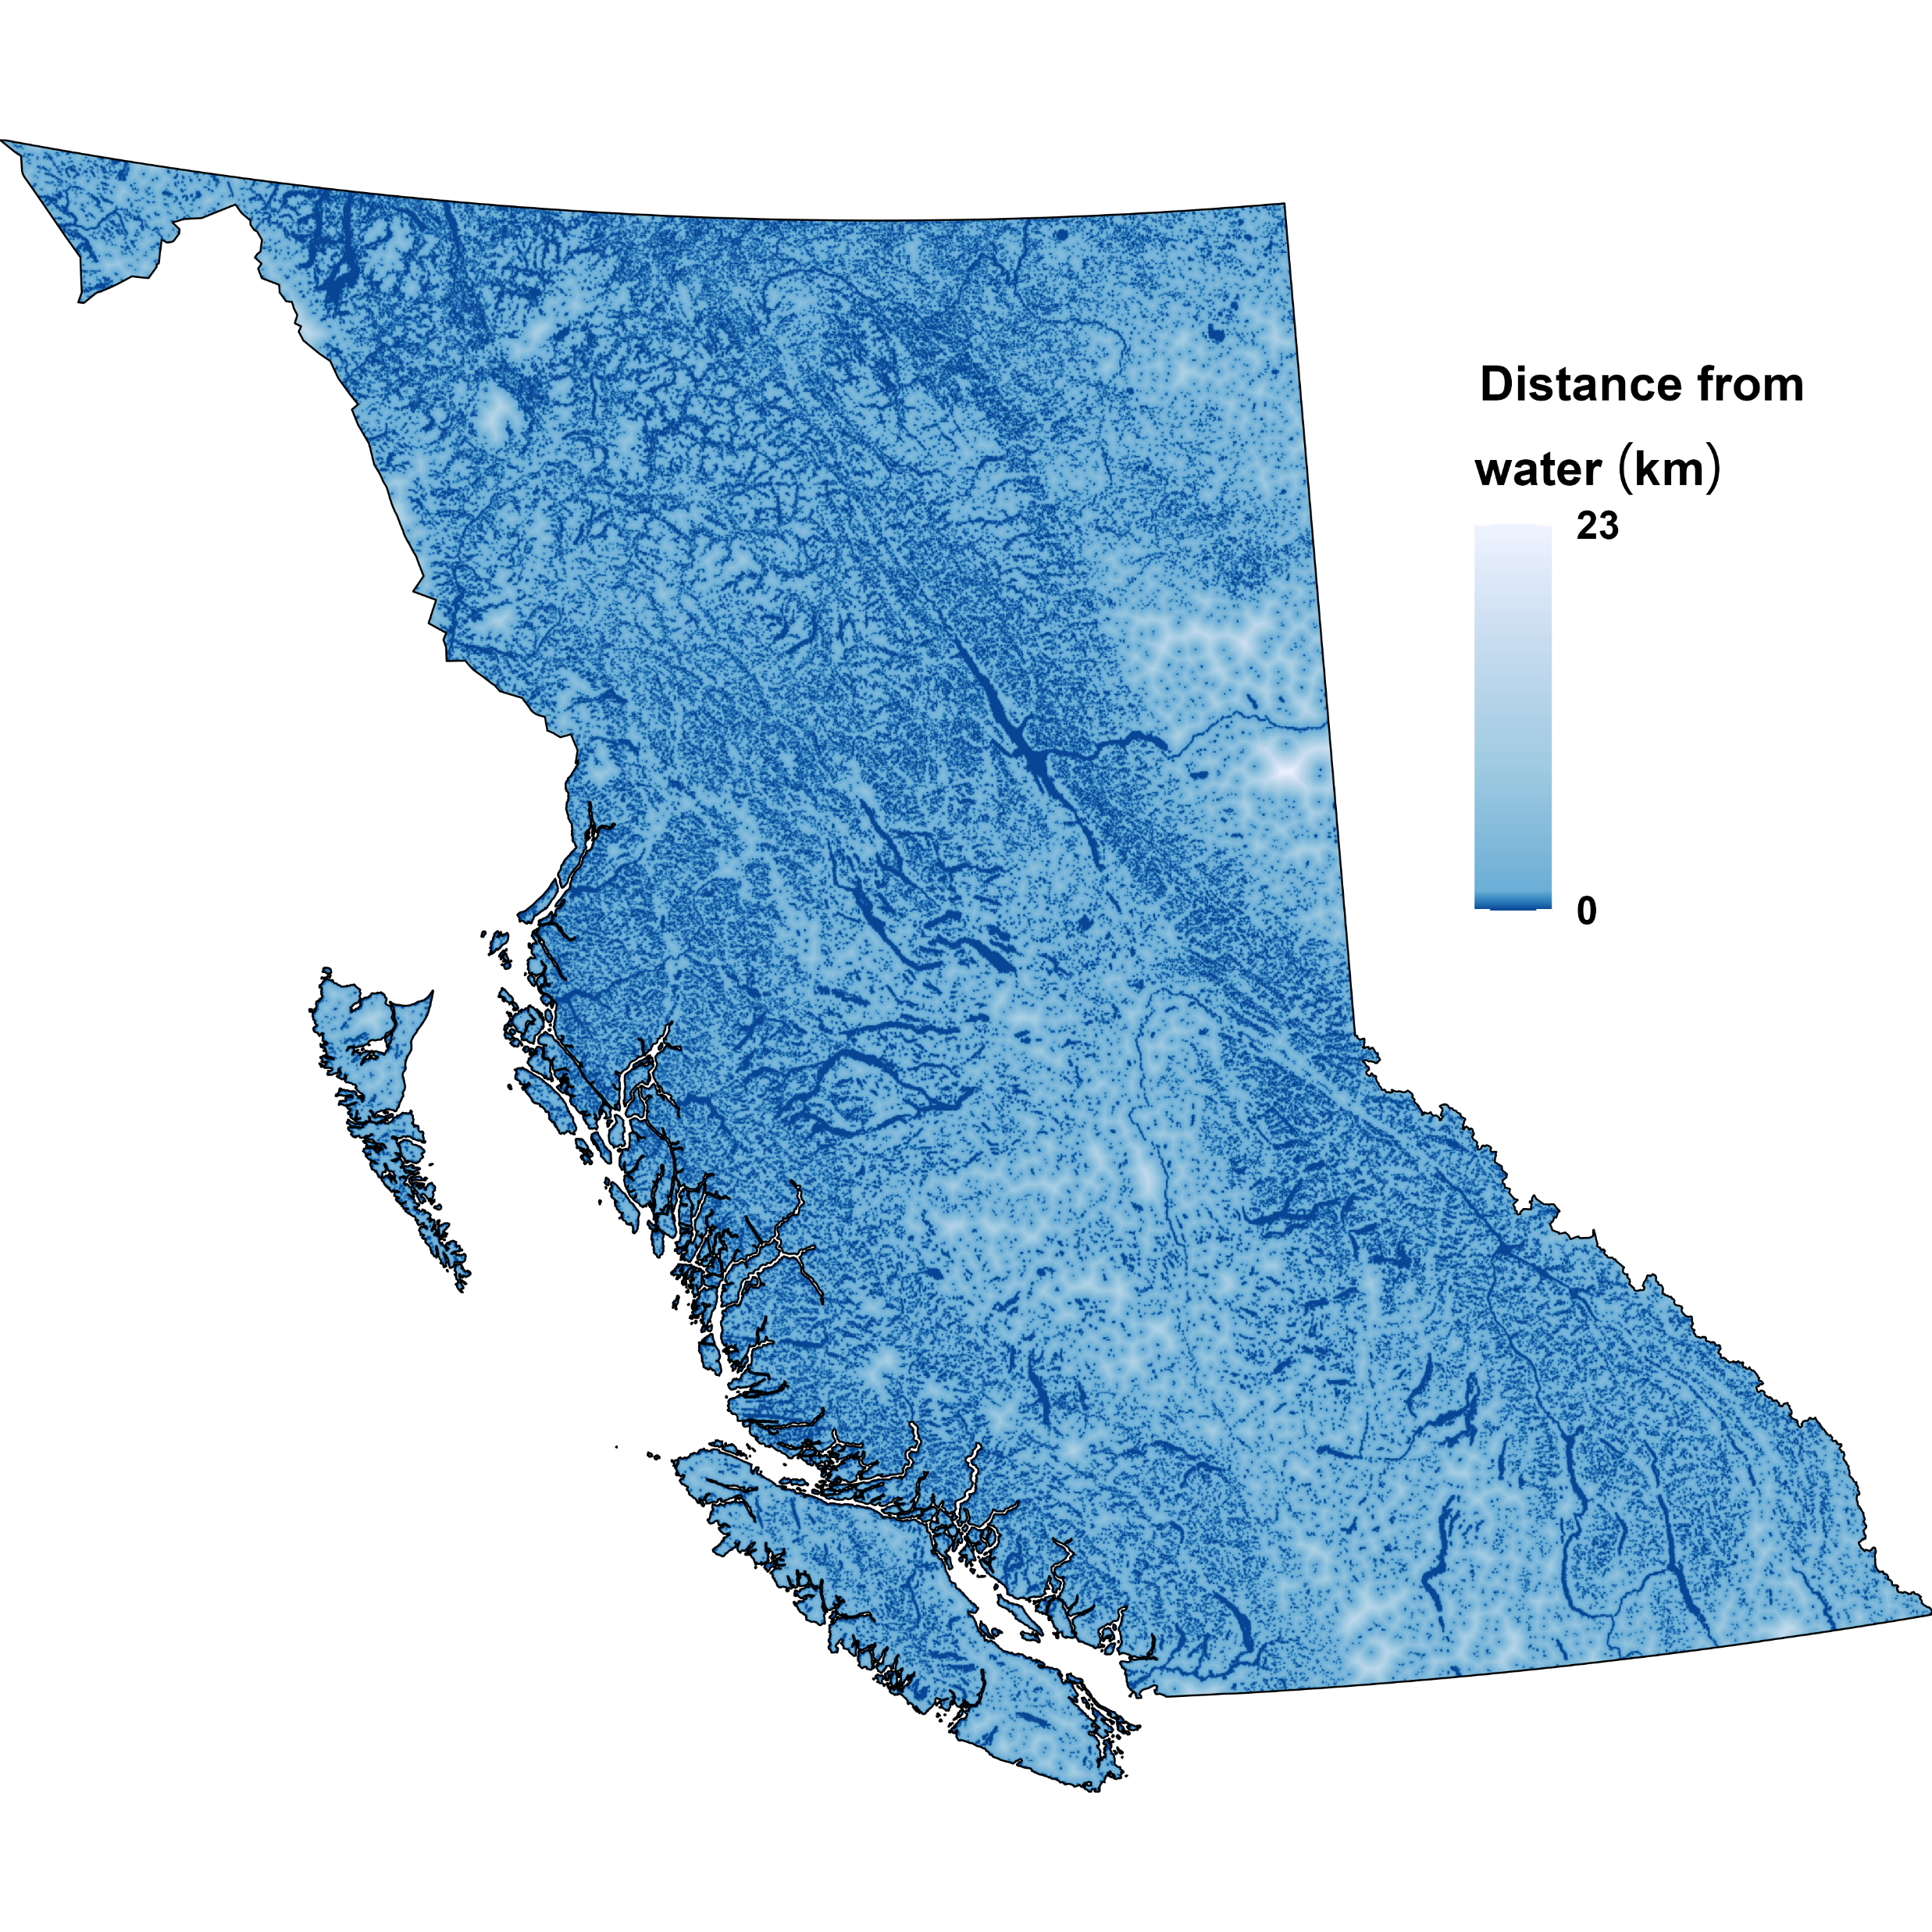
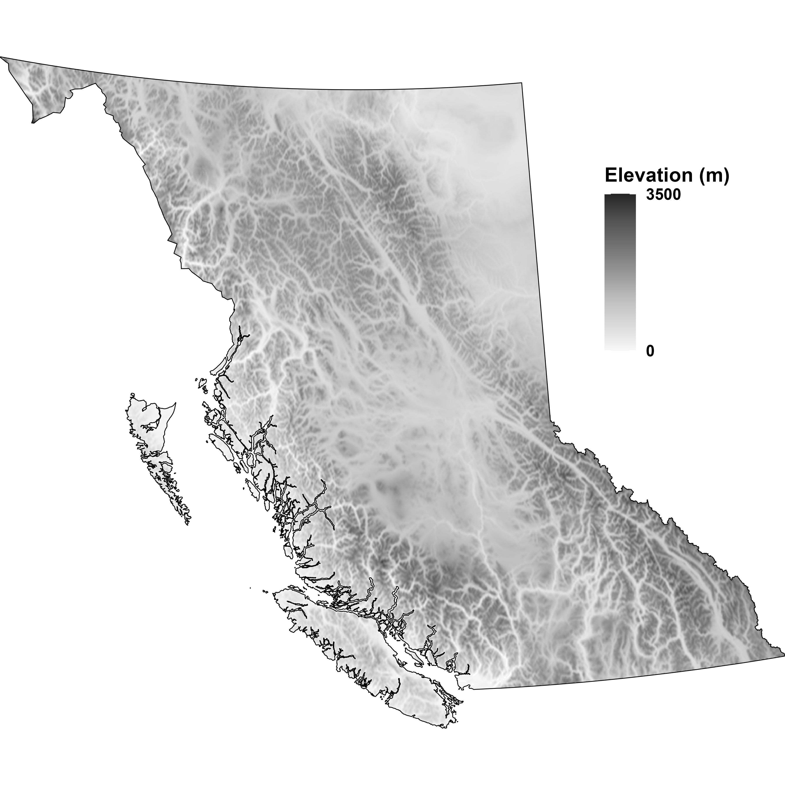

Slide 35
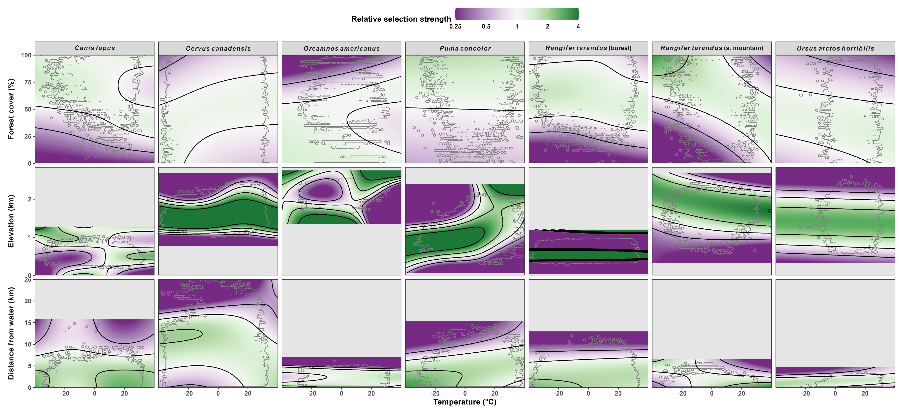
Habitat selection depends on temperature

Slide 36
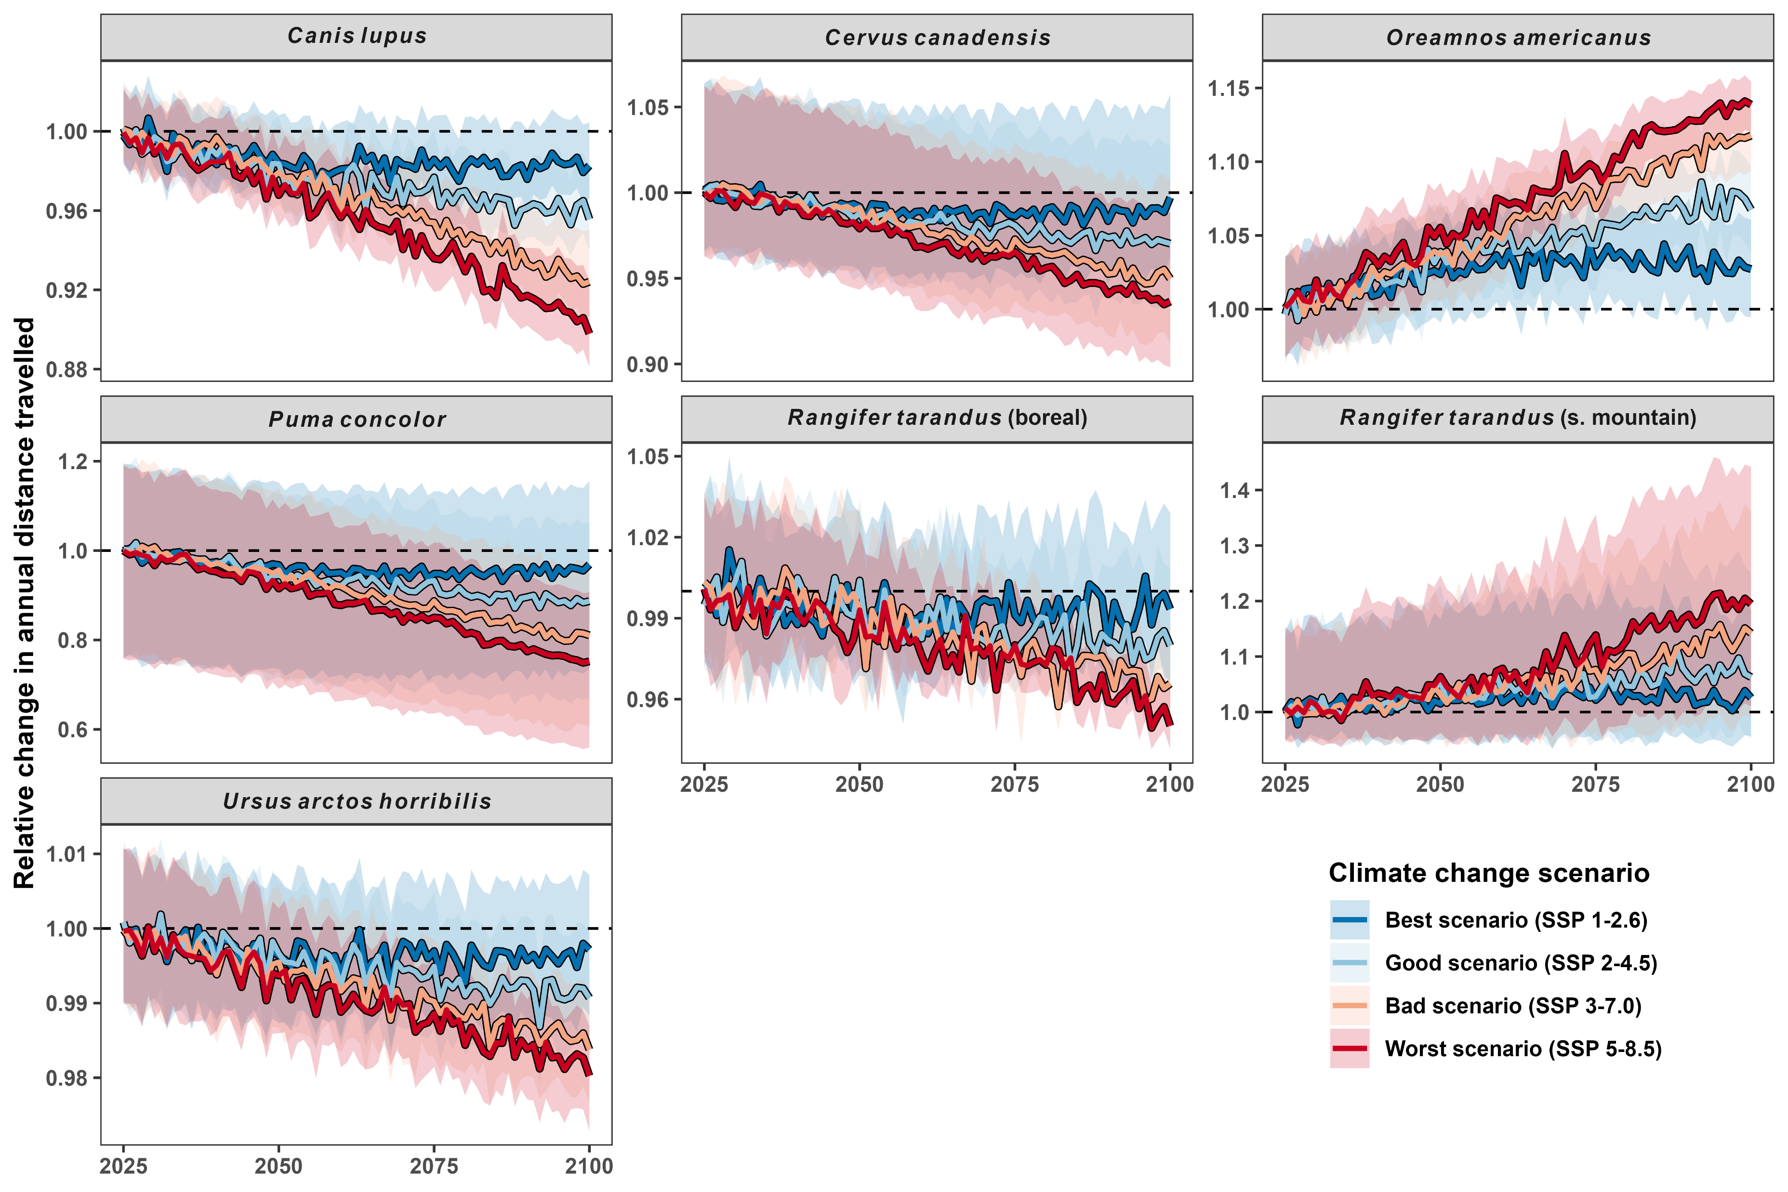
Changes in distance traveled by 2100

Slide 37
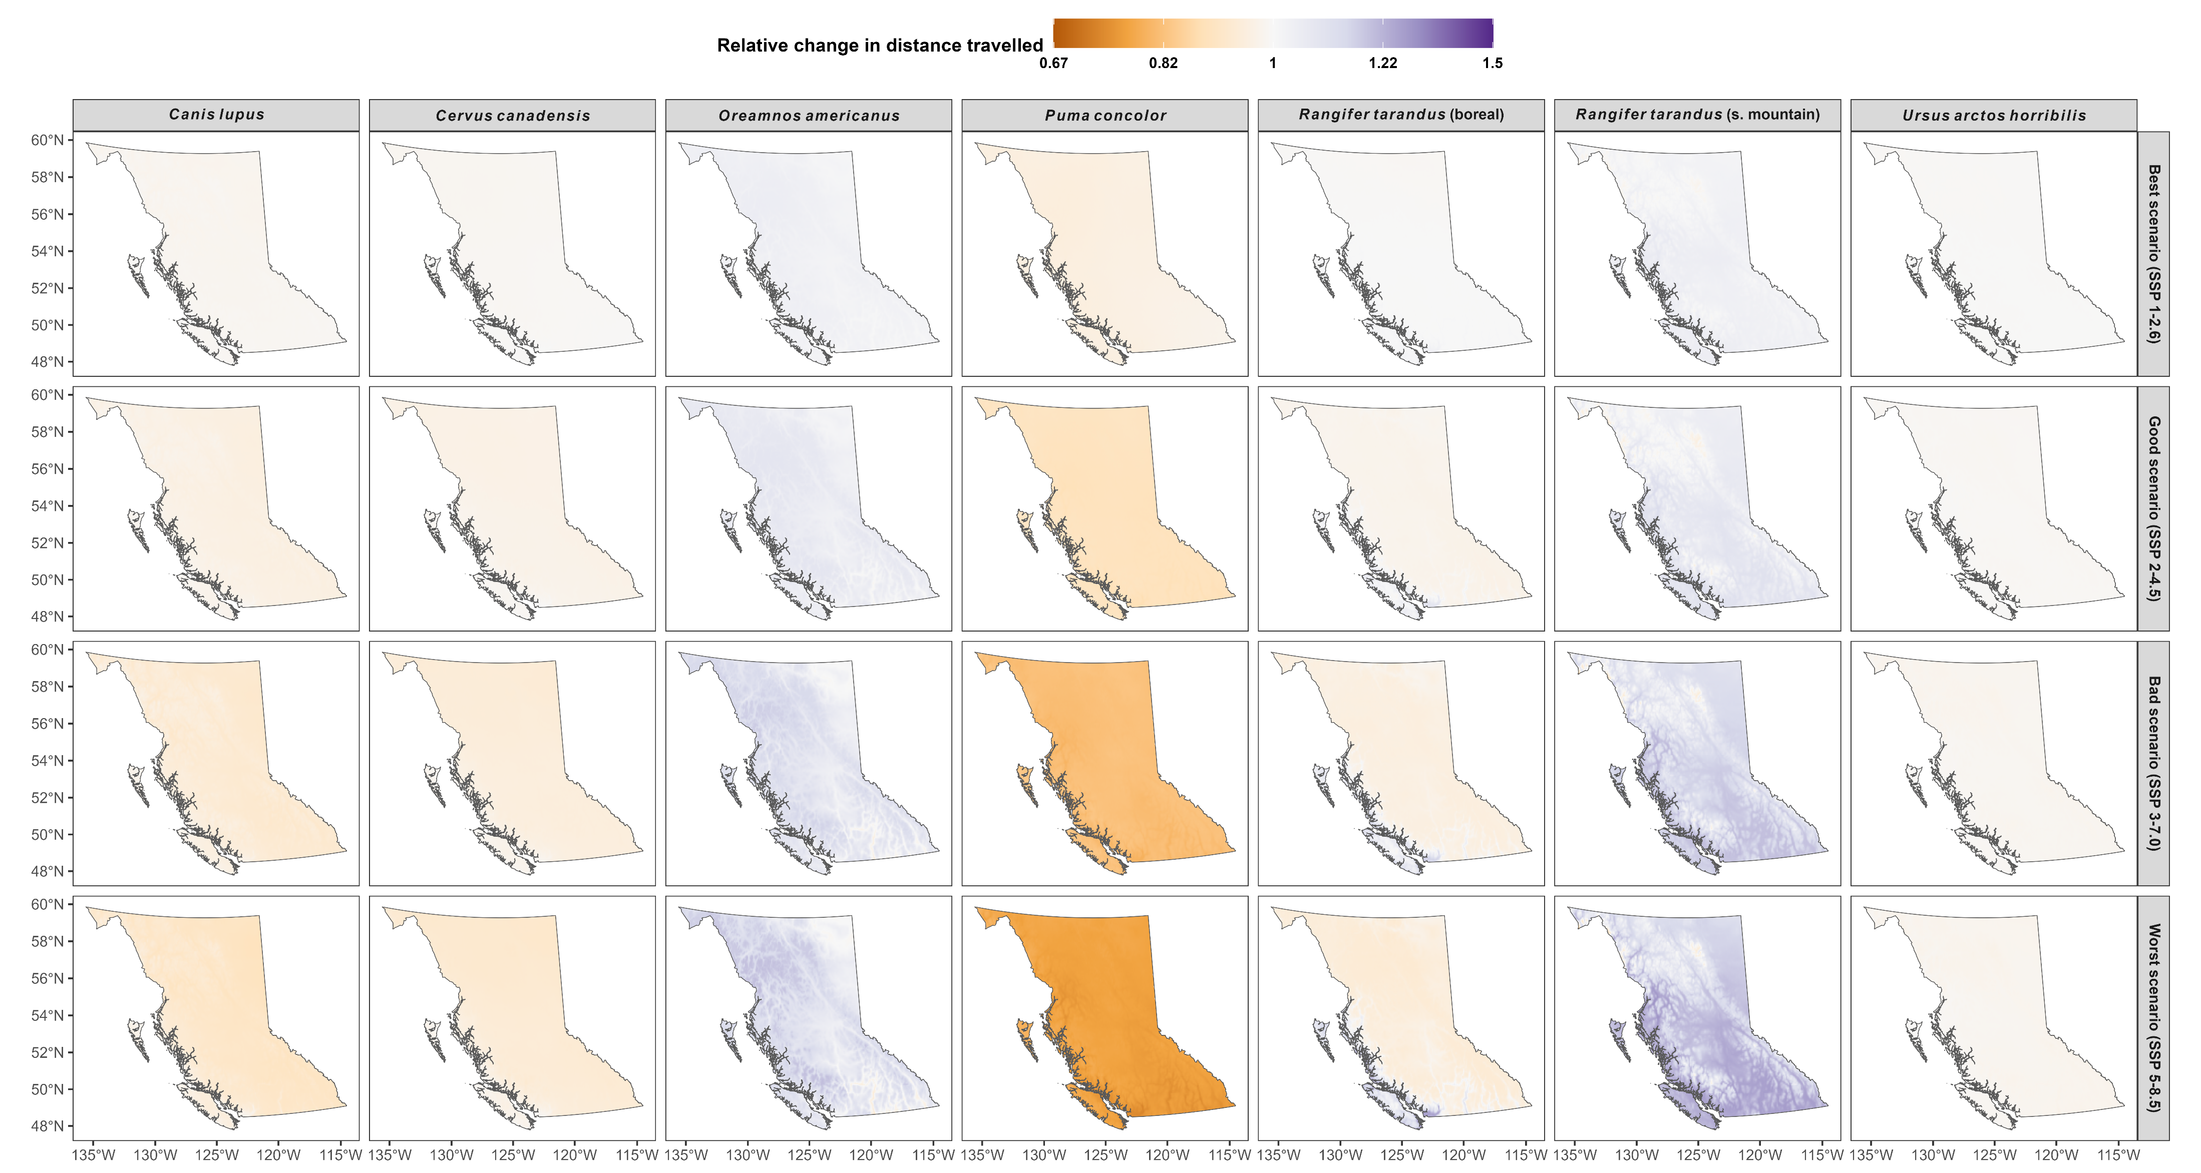
Spatial changes in distance traveled in 2100

Slide 38
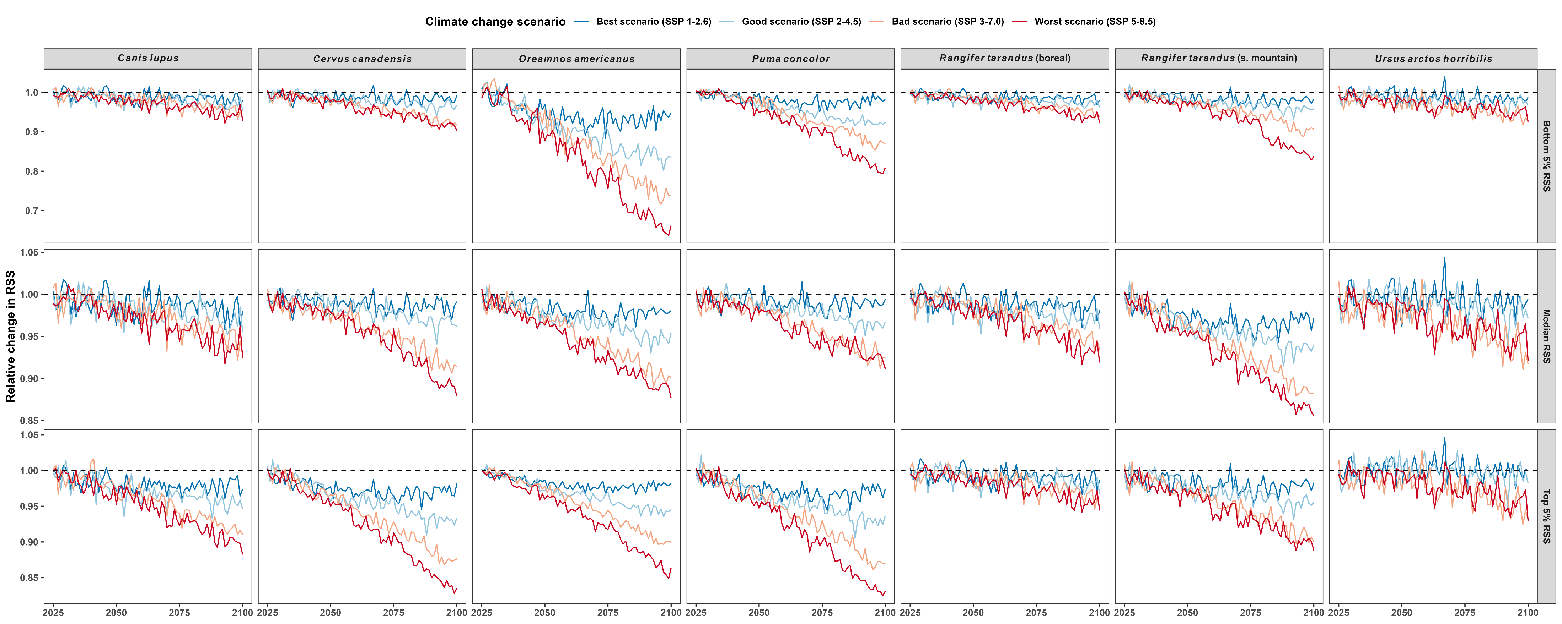
Changes in habitat selection strength by 2100

Slide 39
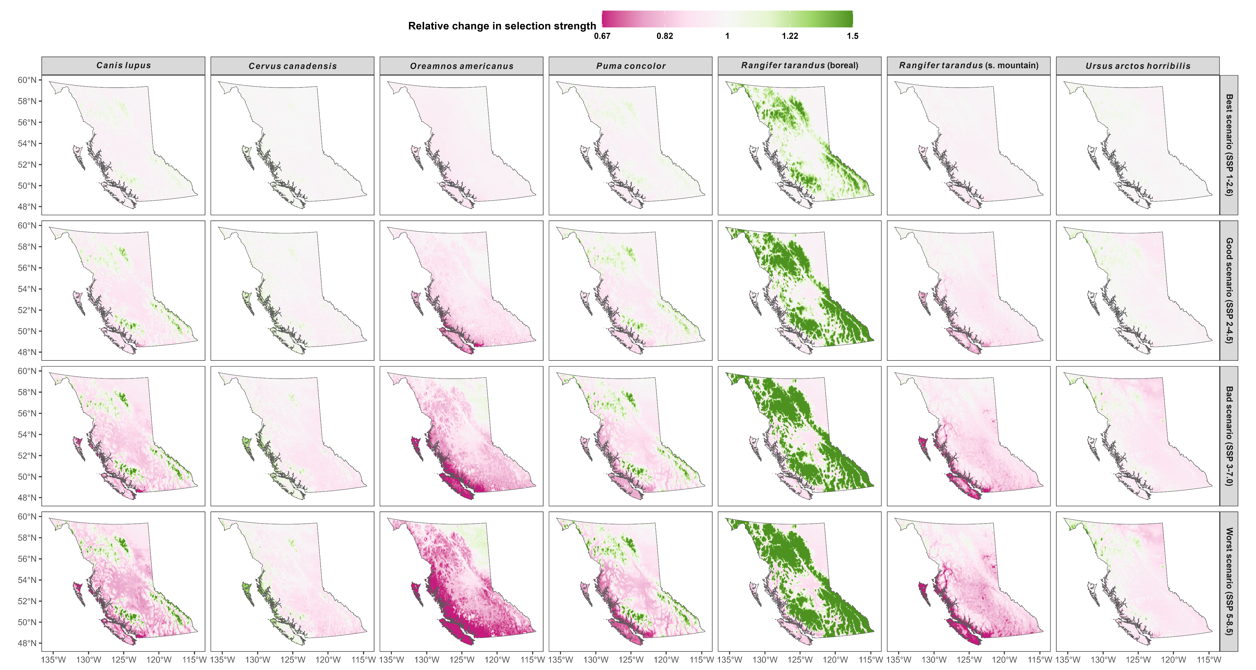
Changes in habitat selection strength in 2100

Slide 40
Phylopic credits
Cougar phylopic: CC BY-NC 3.0: Cristian Osorio & Paula Carrera, Proyecto Carnivoros Australes
Mountain goat phylopic: CC-BY-SA 3.0: Sarah E. Haworth

